Slide 1
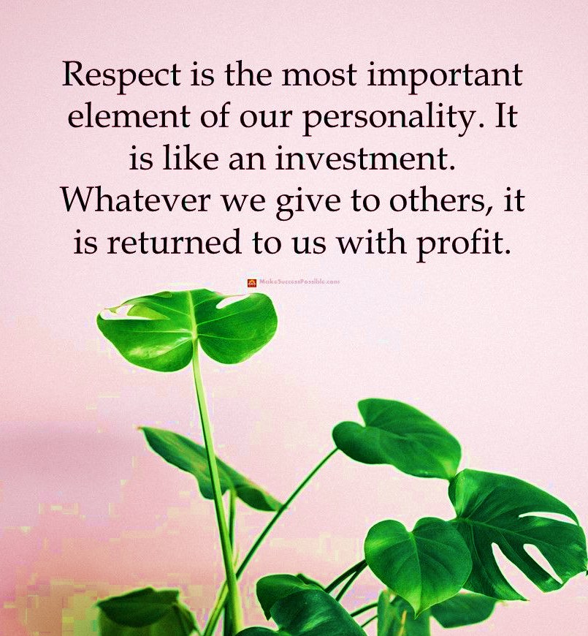
Endazhi-anokiidiing
Respect in the WorkPlace
Notes:
Ayn-duzh-zhi Uh-no-kee-dee-ing
Welcome to Endazhi-anokiidiing – a workshop about Respect in the Workplace.
The concept of respect is often taught at a young age; however, it is always good to remind ourselves and expand our knowledge.
Looking at the quote on this page, what do you think it means when it is said that, “respect is like an investment”?

Slide 2
Steps to a Healthy Work Place
Regardless of the position one holds at their workplace, all employees have one thing in common: the need to be safe.
Notes:
Regardless of the position one holds at their workplace, all employees have one thing in common: the need to be safe.

Slide 3
Introduction
A respectful work environment is essential to your overall success, and will contribute to a healthy, safe work environment for all staff.
Workplace harassment can be based on a variety of factors that differ from one person to another, such as race, sex, and disability.
When we learn to accept and respect the differences between the values and perspectives of those around us, we will find more happiness and success in our job.
MODULE ONE
Notes:
Remember, it is the responsibility of each person to be respectful to one another, and address conflict in a positive manner in order to accomplish a healthy, safe environment to live and work.

Slide 4
Workshop Objectives
Have a clear understanding of respect and self-respect
Identify the actions that constitute harassment and its consequences
Learn what to do if you have experienced or have been accused of harassment
Learn how you can help build a respectful workplace
Notes:
Research has consistently demonstrated that when clear goals are associated with learning, it occurs more easily and rapidly. With that in mind, let’s review our goals for today.
At the end of this workshop, participants should be able to:
Have a clear understanding of respect and self-respect
Identify the words and actions that constitute harassment and its consequences
Learn what to do if you have experienced or have been accused of harassment
Learn how you can help build a respectful workplace
This course will give you the tools necessary to recognize disrespectful behaviors that influence a workplace negatively and understand harassment and your rights and responsibilities under the law.

Slide 5
What is Respect?
Part ONE
Respect is the way we show appreciation to the valuable qualities of others. We are all worthy of this appreciation, as well.
Notes:
Everyday respect plays a meaningful part of our lives, and can take many forms. Respect is the way we show appreciation to the valuable qualities of others, and we are all worthy of this appreciation. People tend to respect those with authority; however, respect for other individuals is not limited to those who appear to have more power than we do. Without respect in our lives, there would be a great deal of conflict.
Respect comes in various forms, including respect for others, self-respect, respect for nature, and respect for laws... Every form of respect is a valuable contribution to success and happiness. It is important realize the impact that courteous gestures have on those around us.
The word respect can be defined in many ways. Respect is all about observation and acknowledgement. It is essential that to show respect to another individual, we must pay attention to their beliefs, along with accepting and valuing these beliefs. It is about thinking and acting in a positive attitude that shows care, consideration, or concern for others, as well as oneself. Respect is important in allowing us to feel safe and voice our thoughts and opinions.
There are many simple ways to show respect for others each day:
Offering help
Being on time
Taking responsibility
Listening to learn
Saying please and thank you
Respecting personal space

Slide 6
Manaaji'idiwin
Cultural Meaning
mutual respect
To have respect is to honor all of creation:
Respect others, the beliefs of others, and yourself.
Accept cultural, religious, and gender differences
Safeguard the dignity, individuality, and rights of others
Treat others the way you would like to be treated. Do not be hurtful to yourself or others.
Live honorably in your actions towards all things.
Notes:
muh-naw-jhee-e-DEE-win
Respect is cultural.
Balance what you need with what you want and recognize how your own greed may be at the expense of Mother Earth.
Do what you can to make a difference and lead by example.
We must respect all life and interconnectedness between us all.
Respect is good medicine.

Slide 7
Notes:
In this video, James Vukelich Kaagegaabaw, the creator of Ojibwe Word of the Day, speaks on respect through a native lens.
His mission is to inspire people to live the good life by sharing ancient wisdom to influence modern solutions through an indigenous perspective.
This recording was created during the beginning of the pandemic. What does it mean for you today?

Slide 8
Being Liked vs. Being Respected
Respect is often earned when you have achieved great accomplishments and have made important decisions for the business.
Notes:
It is natural that humans desire to be liked. When people like you, there is something about you that appeals to them.
Being liked is considered dependent on the other person and what they enjoy. It is evident that you would rather hang out with someone that you like, but work for someone that you highly respect. Being liked and being respected are not the same thing, and should not be used interchangeably. People often find they appreciate the idea of being respected more than just being liked as they become more emotionally mature.
Respect is often earned when you have achieved great accomplishments and have made important decisions for the business. Others may speak highly about your work performance, but in turn think negatively about your personality. In other words, someone may respect you as a worker but dislike you as a person, or like you as a person but disrespect you as a worker. The most powerful and effective employers and employees are both liked and respected.

Slide 9
Owed Respect vs. Earned Respect
Respect can be broken down into two main concepts: owed respect and earned respect.
Owed respect is respect that should be given to each person.
Earned respect often deals with status, including rewards and promotions.
Notes:
Respect can be broken down into two main concepts: owed respect and earned respect. A balance between the two of these concepts helps in the contribution of success, and establishing good relationships among the team.
With owed respect, all members are able to feel valued each day. We owe respect to one another, to ensure everyone feels included in the conversation of the team. Owed respect is not just confined to members who are higher up in the organization, but to each individual, as we all possess our own strengths.
Those who are dedicated to being respectful to others earn respect. Earned respect often leads to increased status within a workplace, including rewards and promotions.

Slide 10
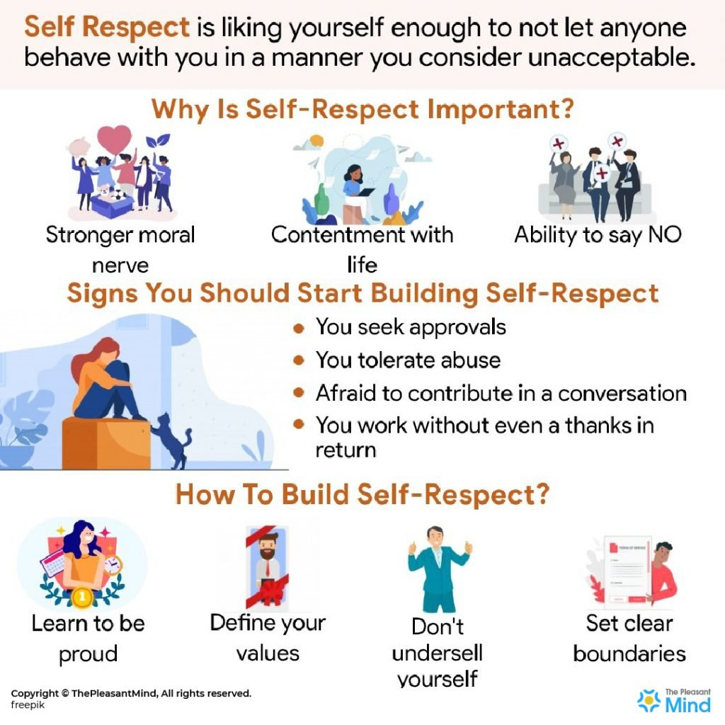
Self-Respect
Self-respect encompasses intrinsic worth, or simply put, pride and confidence in oneself.
Notes:
While we often recognize the importance of respecting others, it is equally as important to have respect for ourselves. Self-respect encompasses intrinsic worth, or simply put, pride and confidence in oneself. You can learn to practice self-respect by challenging yourself in ways that include standing up for yourself, and understanding that not everyone will have respect for you, but continuing to have respect for others. Self-respect includes distancing yourself from negativity, in order to create a positive mindset that will contribute to the success of your work.
Respect for others and self-respect go hand-in-hand. By respecting yourself, you are building your own character. The character that you are building full of self-love and motivation is essential before you can learn to respect others, and have others respect you.
Why is self-respect important?
1. Stronger moral nerve
People who have self-respect take responsibility for their actions and stand by their values and beliefs no matter what happens. They are an example for society and others take inspiration from their courage.
2. Better relationships with others
People who have high self-respect believe that they are worthy human beings and that they deserve love and respect. This results in healthier relationships based on mutual respect. You also learn how to choose better friends, partners, and workplaces that will respect you in the long run.
3. Improved quality of life
If you have self-respect, you will not be bothered by your limitations and flaws. You will accept them and find it easier to work on them and improve yourself.
4. Contentment with life
People with self-respect do not feel the need to compare themselves with others, their successes, talents, skills, and abilities. They are content with themselves and do not feel jealous when other people get ahead. Their personal and professional life improves massively. This ultimately leads to a better quality of life.
5. The power of no
Without self-respect, it is possible that other people will start using, abusing, and mistreating you. Self-respect gives you the ability to say no. You learn how to set boundaries for yourself and protect yourself from those who would want to take advantage of you.
6. Better relationships with yourself
When you have enough self-respect for yourself, you learn how to honor your own needs and desires. You pay more attention to what you want and dedicate energy to your dreams. And you start trusting yourself and develop self-confidence. You also dedicate more time to self-love and self-care.

Slide 11
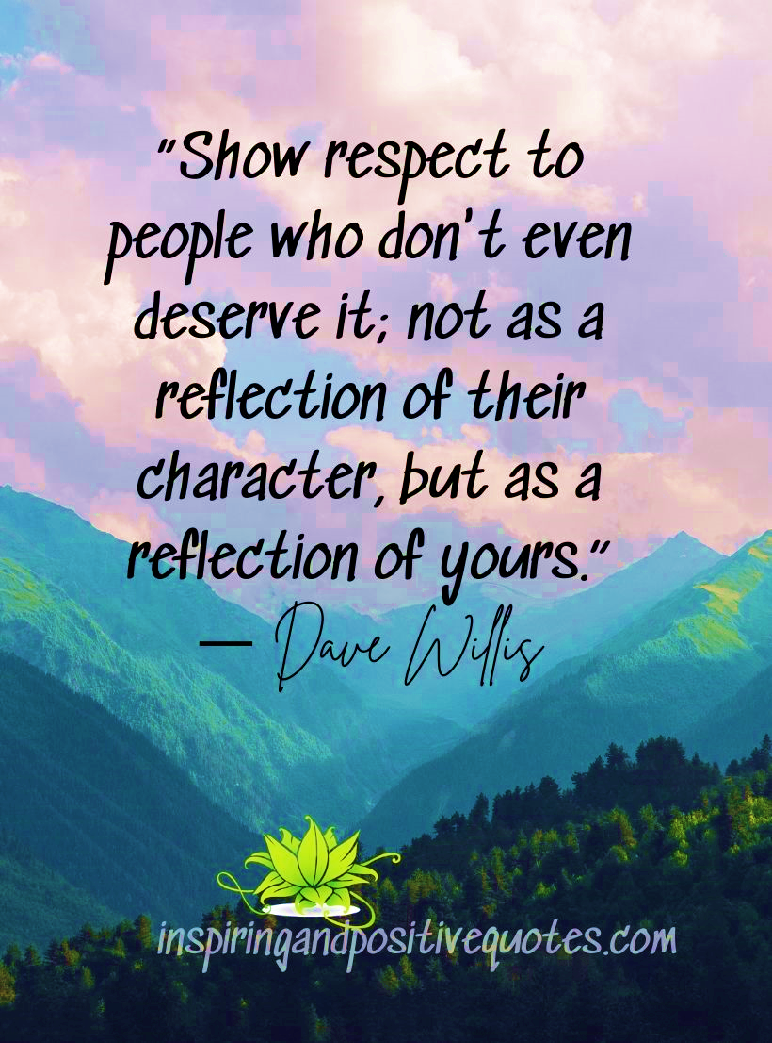
Respect for the Workplace
Embrace a positive attitude
Cleanliness
Taking responsibility and initiative for your work
Treat others with respect
Notes:
Showing respect for your place of work is just as important as showing respect to other employees in the workplace. Acting professionally will guide you in creating a long, successful career.
There are many ways to show respect for your workplace. These include:
Treating others with respect. Treat others with respect, regardless of their position or status. Avoid gossiping, complaining, or engaging in other negative behaviors.
Taking responsibility and initiative for your work. You are responsible for arriving on time, performing to the best of your abilities while helping others on your team, and staying at work for your scheduled amount of time.
Remaining in good health and cleanliness. Some jobs are very demanding or tiring on the body. It is important to have a well-balanced diet, exercise, and adequate sleep, in order to perform well on a day-to-day basis.
Embracing a positive attitude. Your attitude has a big effect on your overall professionalism. Take pride in your work, and show pride for your workplace.
What are other ways to show respect in your workplace?
Dressing appropriately. Always follow the dress code that is established in your work setting, and for your type of position. Ensure your clothes are clean, neat and comfortable so that you are still able to perform adequately.
Understanding and following regulations on scents/allergies, and tobacco use. There are many health conditions that exist in which products such as these are especially harmful. Respect these regulations, as they are there for a reason.
Maintaining confidentiality. Certain information is confidential in the workplace, and should not be included in casual conversations outside of this setting. Be attentive of the conversation, and keep personal work information inside the work environment.

Slide 12
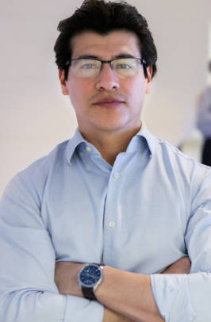
Review
Defining Respect
Cultural Meaning
Being Liked vs. Being Respected
Owed Respect vs. Earned Respect
Self-Respect
Respect for the Workplace
Notes:
William works at the Government Center. His fellow employees admire him for his hard work. He arrives to work on time each day well dressed, and ensures personal cleanliness. While he is at work, he takes initiative and responsibility for his work, and is always willing to help others. William is consistently showing respect and recognition to those around him, in which his behaviors have earned him a high level of respect from his team and supervisors.
Do you think William enjoys his job?
William gets promoted to a coordinator position in his department. Is this owed respect or earned respect?

Slide 13
1a. What is respect?
A. Being opinionated, and ensuring that our own values are the correct ones
B. The way we show appreciation to the valuable qualities of others
C. Judging someone by their values, attitudes and behaviors
D. Something that will cause a loss of productivity and increased stress in the workplace
Notes:
B. Our background and personal preferences help us to form a definition of respect. It is important to show appreciation to the valuable qualities of others.

Slide 14
1b. What does every form of respect help create?
A. Happiness
B. Success
C. Self-deprecation
D. Both A and B
Notes:
D. Respect helps contribute to both happiness and success, along with many other great things and benefits for the workplace.

Slide 15
1c. How can we show respect each day?
A. Offering help
B. Listening to learn
C. Being on time
D. All of the above
Notes:
D. These are all simple ways in which we can show respect each day.

Slide 16
1d. What does self-respect include?
A. Pride and confidence in oneself
B. Avoiding difficult challenges out of fear
C. Drawing yourself towards negativity
D. All of the above
Notes:
A. Self-respect encompasses pride and confidence in oneself.

Slide 17
1e. What are some ways in which we can show respect for the workplace?
A. Dressing appropriately
B. Maintaining confidentiality
C. Taking initiative
D. All of the above
Notes:
D. These are all important ways in which we can show respect and professionalism for the workplace.

Slide 18
Disrespectful Behavior
Part Two
Disrespectful behaviors are not part of our jobs, and can lead to lower productivity, stress and various long-term health issues.
Notes:
Three main actions that constitute harassment:
When someone is doing something to make someone uneasy.
When someone is saying something to make someone feel uneasy.
When someone knowingly puts anothers life at risk in some way.
Does disrespectful behavior make a difference in your home as well, or just at work?
Disrespectful behaviors can lead to lower productivity, stress and various long-term health issues. Unfortunately, instances of disrespect can be common and normalized in our everyday lives. It is important to recognize disrespectful actions in order to deal with the problem, and find a positive solution.

Slide 19
Why These Behaviors Arise
Harassment
and
Discrimination
Our background plays an immense role in shaping the way we interact with others.
There are many motives that will cause people to behave in a disrespectful manner, and in some cases, they may not feel as though they are acting disrespectfully.
Why do people do this:
To get attention
To feel powerful
To gain self-esteem
To get revenge
To be mean
Notes:
There are many motives that will cause people to behave in a disrespectful manner, and in some cases, they may not feel as though they are acting disrespectfully.
Everyday stresses can also play a part in how we express ourselves to others. Personal problems and frustrations can lead to angry outbursts that would not normally occur. Someone who embodies low self-esteem will typically express negativity to their surrounding environment.
It is important to try to think before acting in these circumstances, and remember that lashing out in a disrespectful manner can have lasting, negative effects.
What are other better and healthier ways people could...
Get attention?
Feel powerful?
Gain self-esteem?

Slide 20
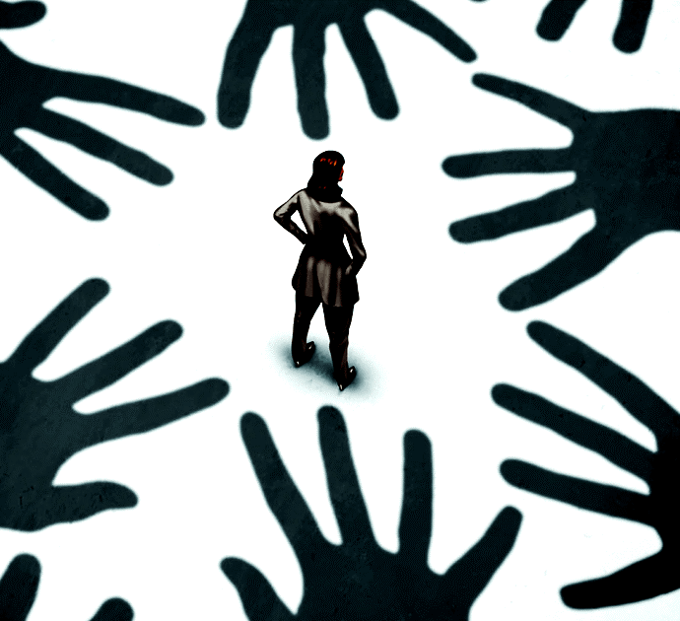
Forms of Harassment
Sexual Harassment
Physical Harassment
Psychological Harassment
Verbal Harassment
Intimidation
Cyber Bullying
Power Harassment
Discrimination
Notes:
Harassment is a form of discrimination that involves unwanted physical or verbal behavior. These behaviors are typically offensive, but are common, and often not reported or even noticed in the workplace. Harassment is disrespectful behavior that persists over time, and in some instances is even against the law. Harassment may not always be recognizable; however, more obvious disrespectful conduct, such as offensive jokes, threats, or name-calling are all considered harassment.
There are many different forms of harassment that can arise in a workplace setting.
Sexual Harassment: Unwanted sexual behavior or sexual gestures, invading one’s personal space, or any unwelcome conduct. Sexual harassment is against the law, and should be reported immediately.
Physical: Actual or threatened assault including hitting, tripping, kicking, punching or unwanted touching; malicious or insulting gestures. Physical attacks, direct threats, or destruction of one’s property.
Verbal: Unwelcome remarks, jokes, innuendos, or taunts causing offense or embarrassment; name-calling, swearing, bullying, expressing or insinuating threats, incessant teasing, wolf whistling, or spreading rumors.
Psychological: Shunning or ostracizing, stalking, staring; gesturing; preventing someone from joining in an activity; hiding, damaging or taking another’s property; displaying objectionable materials, graffiti, or pictures. This behavior includes disregarding, denying, or isolating the individual.
Intimidation: Use of physical or organizational power to coerce a person to perform a particular action, or to instill a feeling of humiliation or intimidation.
Power Harassment: Characterized by a power imbalance, that includes excessive demands, or acts of intimidation.
Cyber Bullying: Any type of harassment via the internet.
Discriminatory Harassment: Harassing an individual based on gender, race, religion, age, disability, pregnancy, parental status, etc.
Religious: An outward disrespect of religious beliefs - not allowing a day off for specific religious holidays
Sexual orientation: Bisexual, heterosexual, homosexual, asexual, etc. persons may be subject to comments (a heterosexual woman may be harassed for being a mechanic).
National Origin: Birthplace, ancestry, culture, or linguistic characteristics common to a specific ethnic group.
Categorizing harassment will not lessen the effects of it, but it may be easier to recall and report more specific types of harassment. Keeping personal notes and documentation of the details of what you are experiencing will serve as reference points that you might not otherwise be able to recall when needed.

Slide 21
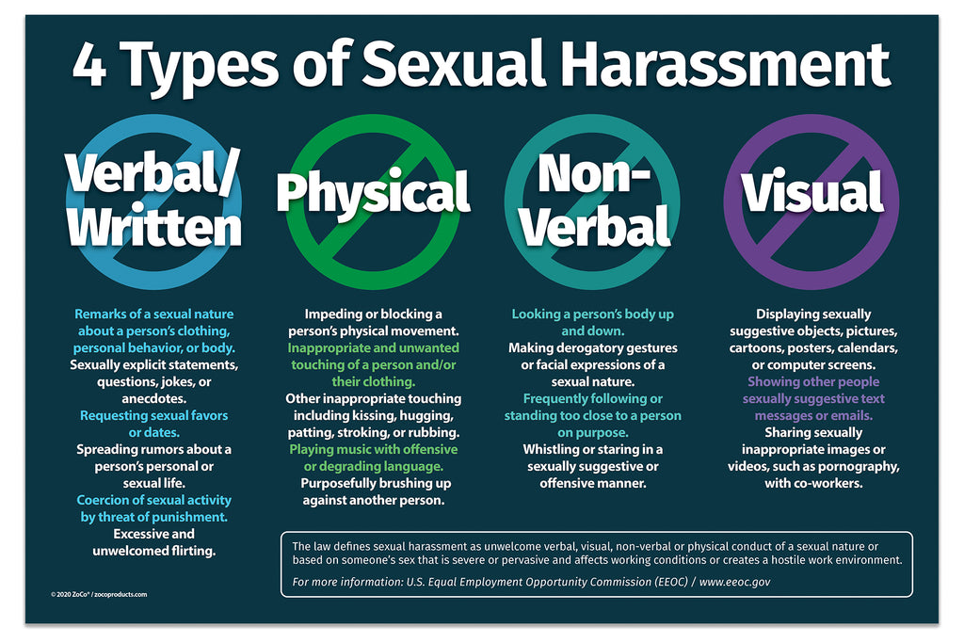
Sexual Harassment
Unwelcome touching
Requests for sexual favors
Staring or stalking
Displaying suggestive texts
Notes:
Some people may view sexual harassment as unwanted touching or blatant requests for sex, but there are other, often more subtle behaviors that are also considered sexual harassment.
It is sexual harassment when one person’s conduct interferes with another person’s work performance, or an intimidating, hostile, or offensive work environment is created by this conduct.
Examples of sexual harassment:
Unwelcome touching
Requests for sexual favors
Comments, jokes or innuendos related to sex
Blatant, unsolicited requests for sex
Prying into an individual’s private life
Exhibiting sexual material
Continued, unwanted invitations for a date
Staring or stalking
Sexually based insults
Distasteful communication
Staring at another in a manner that is sexually suggestive
Making offensive comments about someone else’s looks, body parts, or clothing
Intentionally brushing up against another
Displaying sexual pictures in a public setting
Sending emails with sexual content
What is not sexual harassment?
Mutual sexual attraction
Behavior based on friendship
Consensual, reciprocated interaction

Slide 22
Discrimination
Discrimination is the unequal treatment of a fellow employee, or applicant, based on personal attributes such as race, sex, age, disability, or sexual orientation.
Notes:
Discrimination is a violation of human rights, whether it is intentional or unintentional. Despite whether there is intent in the act of discrimination, it can be harmful and lead to a toxic work environment.
Examples of employment discrimination include, but are not limited to:
Disallowing an employee time off to celebrate a religious holiday
Being assigned impossible tasks
Unequal pay as an employee with the same qualifications and experience
Having information withheld from you
Firing an employee because they are pregnant, or injured

Slide 23
Legal Ramifications
Harassment is against the law.
It has lasting negative effects and is detrimental to the lives of everyone involved.
Notes:
Harassment in the legal sense relates to actions that appear to be distressing, upsetting, or threatening. Experiencing uncomfortable situations may be more than an offense against an individual, it can be a crime. Harassment can result in both civil and criminal consequences for the perpetrator.
Several federal laws have been enacted to not only protect against harassment, but also discrimination as a whole. Harassment accusations can range from a minor infraction to a serious felony. Before considering what the defendant should be charged with, courts weigh various considerations, including past crimes and if the defendant violated a restraining order.
When someone targets victims based on their national origin, ethnicity, religion, gender, sexual orientation, age, or disability, this is known as profiling.
Cases of civil harassment are not prosecuted as criminal offenses. In civil harassment cases, you can file a civil lawsuit alleging discrimination due to the harassment. In the following situations, civil harassment lawsuits are very common:
Physical Harassment
Written or Verbal Harassment
Visual Harassment
Harassment in the Workplace

Slide 24
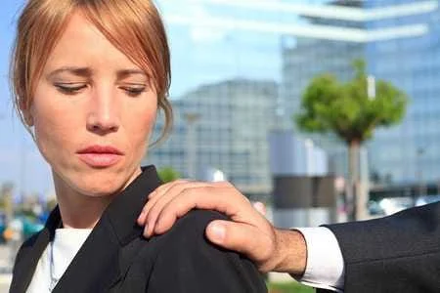
Identifying Harassment
The motive behind a statement is the determining factor of whether or not it is harassment.
Notes:
The ability to identify harassment may not be as easy as it sounds. There are obvious forms of harassment, for example, if a person is making racial slurs, or homophobic remarks. Other times, it may not be as obvious, but still considered a form of harassment.
The motive behind a statement is the determining factor of whether or not it is harassment. For example, the statement ‘You look great today’ can be a compliment if a co-worker with whom you feel comfortable makes it. On the other hand, if it is made by a co-worker with whom you generally do not feel comfortable, or you do not really know, it could make you uneasy, which could signify harassment.
Three main actions that constitute harassment:
When someone is doing something to you to make you uneasy.
When someone is saying something to you to make you feel uneasy.
When someone knowingly puts your life at risk in some way.
Ask yourself:
Was the behavior directed at me, was it improper for the workplace?
What was happening at the time of the incident?
Is this a repeat occurrence?
Is my co-worker a friend outside of work?
Do I feel threatened?
Are there any outside stressors that could be putting me on edge?
How did the incident leave me feeling?
Have I done my due diligence by asking that this behavior stop?
Have I received an apology from my co-worker?
Asking yourself these questions may help you determine what your next step will be. Maintain your composure and let your self-confidence override any self-doubt. If you have concerns, take action.

Slide 25
What is Not Harassment?
A compliment on the appearance of another employee
A friendly hug, or pat on the back
Assigning tasks to an individual
Disputes, or disagreements
Notes:
There may be times when you become aggravated by the actions of those around you. Their actions may result in you having a bad day, but what really constitutes workplace harassment?
As mentioned, circumstances of harassment are not always obvious or can be contradictory as to whether these instances are considered harassment, especially since we all have different perceptions of what is considered respectful. There is a fine line as to whether conduct is harassment, or not harassment.
For an action to be determined as harassment, it must be improper and offensive, causing harm or humiliation.
When considering whether an incident is harassment, a few questions may come to mind:
Does this action offend you, or negatively affect you?
Is this behavior personally directed at you?
Has this incidence occurred more than once?
Is this behavior inappropriate, or improper?
Has this affected you emotionally, or physically?
Are you being treated differently from other employees?
Actions that are not considered harassment are those that have mutual consent between the employees, including:
A compliment on the appearance of another employee
A friendly hug, or pat on the back
Assigning tasks to an individual
Disputes, or disagreements
Do not confuse being “managed”, with being harassed. Employees have specific duties to perform, usually within a specific time frame. Managers have a duty to ensure the workplace is run efficiently.
You and a co-worker disagree; the disagreement may become heated. Unless there is a continuous barrage of accusations and insults that last longer than the particular argument, this does not constitute harassment.
An employee’s level of personal accountability determines how well they handle stress. If you’re unable to deal with the stress personally, the reasons behind it may need to be investigated.
Necessary organizational changes may be uncomfortable, but do not constitute harassment.
Witnessing what you consider harassment may just be a consensual relationship between co-workers
A friendly pat on the back is acceptable in the workplace
Unfortunately, there are some instances where an employee may allege harassment, when it is not actually a form of harassment. For example, if an employee is not satisfied with the outcome of a performance review, they may allege harassment, as they perceive they are being treated differently. Allegations of harassment are serious, and it is crucial to be certain that these conditions constitute harassment prior to any further action.

Slide 26
Review
Why These Behaviors Arise
Forms of Harassment
Sexual Harassment
Discrimination
Legal Ramifications
Identifying Harassment
What is Not Harassment?
Notes:
Simon works as a data entry clerk. Lately, Simon has been feeling as though his boss, Sam, is not treating him fairly. Sam had discussed Simon’s performance review, and informed Simon that he needs to better his time management skills, and improve his numbers in order to reach the same number of entries as the other data entry clerks in the office. Simon sees this as a form of power harassment from Sam, and approaches Louise, the human resources representative with his concerns.
Louise examines the situation and takes everything Simon has informed her very seriously. She explains to Simon that this is not Sam harassing him, but that Sam is providing these instructions to help improve Simon’s work performance. She proceeds to help Simon understand what harassment is, and sets up a meeting with both Simon and Sam. The three of them discuss ways in which Simon can improve, as well as how Sam can ensure Simon feels respected by him.
______________________________________________
Meg agreed to go out with Joe, another employee, when he asked her out for coffee. Afterwards, Meg declined a second date.
Over the next week, when Meg walked to the break room, she felt like Joe was following her. He continually asked about her personal life outside work, especially focusing on whether or not she was seeing anyone romantically. Meg asked Joe to stop, but he did not change his behavior. Meg was afraid to tell her boss, as she'd seen him joking around with Joe and she suspected that the two were close friends.
When Joe asked her out a third time, Meg looked at her company's anti-harassment policy. She told her Human Resources Manager about the situation with Joe, and together, she and the human resources manager talked to Joe's boss, who addressed the allegation in a direct and professional manner.
____________________________________________
Coral walked into the sales meeting late. A hush fell over the room. “What’s going on?” she asked.
Monica pulled Coral aside and explained, “There are photos of you being shared on our internal email; they are a bit odd.”
Coral knew exactly who was sending them. She went directly to that person and told him to immediately take them down!
“It’s just a bit of fun! You look good on a tiger’s body.” Malcolm said
Coral asked once more, “This behavior is unprofessional, and I do not want to be associated with it! Please remove them, or I will be lodging a complaint with HR!”
Malcolm questioned her, “And what will you tell them? That your co-worker was poking fun at you? Grow up, Coral!”
“I will explain that this is Psychological Harassment.”
Malcolm refused; he didn’t see the harm in a photo-shopped picture of his co-worker.
Coral submitted a claim of harassment against Malcolm via the company’s new online reporting system.
____________________________________________
Nina was struggling at work with a co-worker who seemed to take every opportunity to be rude to her. She constantly made comments about Nina’s outfits, the style of her hair, and the quality of her work. Nina was discussing this situation with her mother; trying to work out what the best course of action would be. Nina’s mother said, “Maybe you’re just over sensitive. When I worked at ABC Company in the 80s, my female co-workers often made snide comments to one another. We just learned to put up with it, as awful as it was.”
Nina explained, “Mom, things have changed a lot since you worked for that company. I cannot continue listening to her comments. I’m so stressed, I don’t even want to go to work! When I am there, I find it hard to concentrate! The quality of my work has suffered because of this.” “I’ve made up my mind, “Nina said. “tomorrow I’m going to speak to someone from HR and see what can be done.” Nina’s mother agreed, “I’m proud of you for taking charge of this situation.”
____________________________________________
Carla frowned as she sat her desk, and she sighed as she became lost in thought. Fareed stopped as he saw the upset look on Carla's face. "Hey, Carla. Is everything okay?"
Carla said, "It's just Vivian again. Every time I talk to her, she's spreading some rumor about someone. The worst part is I feel like there's nothing I can do about it."
Fareed said, "That’s harassment. If we tell our boss about it, he'll respond to the situation in a timely fashion."
"How do you know that's what's going to happen?"
Fareed pointed to the side wall. "The office just put up a flyer about our anti-harassment policy. It goes over what to do when things like this happen."
They told their boss that afternoon, and in a short period of time, appropriate action was taken in response to the allegation.

Slide 27
2a. All employees have one thing in common:
A. The same pay scale
B. The same lunch hour
C. The right to be safe
D. The right to leave at the same time
Notes:
C. Regardless of the position one holds at their workplace, all employees have one thing in common: the need to be safe.

Slide 28
2b. What is harassment?
A. A form of discrimination
B. Unwanted physical or verbal behavior
C. Behavior that will persist over time
D. All of the above
Notes:
D. These are all true in defining harassment.

Slide 29
2c. While some people may view sexual harassment as unwanted touching or blatant requests for sex, what else can also be sexual harassment?
A. A supervisor asking you to work on a weekend
B. Overt, obvious behaviors are the only cases of sexual harassment
C. More subtle behaviors are also considered sexual harassment
D. Mutual attraction in the workplace
Notes:
C. Some people may view sexual harassment as unwanted touching or blatant requests for sex, but there are more subtle behaviors that are also considered sexual harassment.

Slide 30
2d. How do you know whether an incident is a form of harassment?
A. It has offended, or negatively impacted someone
B. It was inappropriate, improper or offensive
C. It was personally directed at a particular individual
D. All of the above
Notes:
D. Harassment is capable of causing all of the above, along with many other harmful outcomes.

Slide 31
2e. When is harassment acceptable in the workplace?
A. When an employee is just joking around
B. When it's after hours in the office
C. When there are no supervisors present
D. It is never acceptable
Notes:
D. Any type of sexual harassment is prohibited.

Slide 32
Proper Procedures to Resolve
PART 3
In order for the process to go as smoothly as possible, and for the problem to be resolved as quickly as possible, it is vital that all involved follow the proper procedures.
Notes:
In order for the process to go as smoothly as possible, and for the problem to be resolved as quickly as possible, it is vital that all involved follow the proper procedures, whether you are the person who is being harassed, or the person accused of harassing someone else.

Slide 33
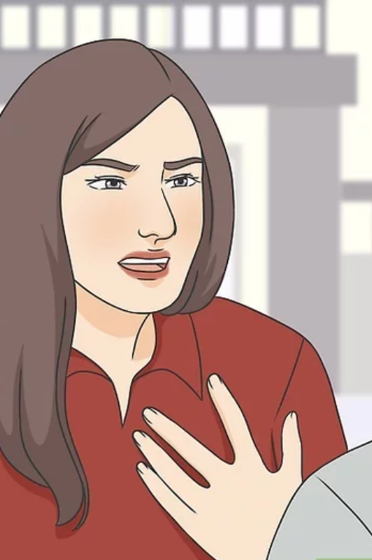
How to Address the Situation
It is best to discuss the matter with your supervisor, or case manager in a calm, informative manner.
Notes:
One might consider that the most direct method of dealing with a case of being falsely accused is to confront the individual who made the accusation. However, in the workplace, this may not be appropriate or productive.
It is best to discuss the matter with your supervisor or case manager in a calm, informative manner. If the incident was reported following proper procedures, the accused would eventually be approached to offer their recollection of the events.

Slide 34
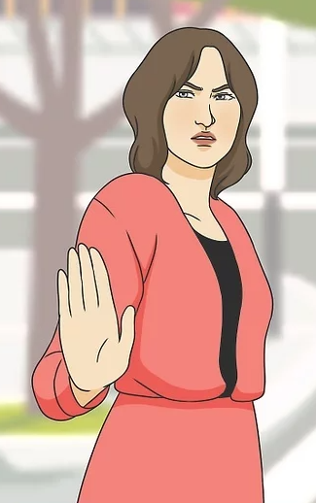
If You are Being Harassed
Tell the person to stop.
Write down what happened.
Do not retaliate.
Consult with your supervisor.
Notes:
Whether physical, verbal, or psychological; harassment is a very uncomfortable situation for the victimized individual. At first, it may even feel like nothing can be done to ease the pain experienced, but when one is able to separate from the emotional aspect of it, a resolution can be in plain sight.
The first thing to do if you are being harassed is to tell the harasser to stop because what they are doing is wrong. In most cases, when the person is informed of their behavior, they may understand that what they are doing is inappropriate and take the necessary steps to rectify the situation.
In addition to verbally telling the harasser to stop, it is important to consult with the proper authority (e.g., Supervisor, Case Manager, or Human Resources) so they can document the incident and make sure all other points outlined within their policy are being followed.
You may also want to keep written documentation of the incident for your own records.

Slide 35
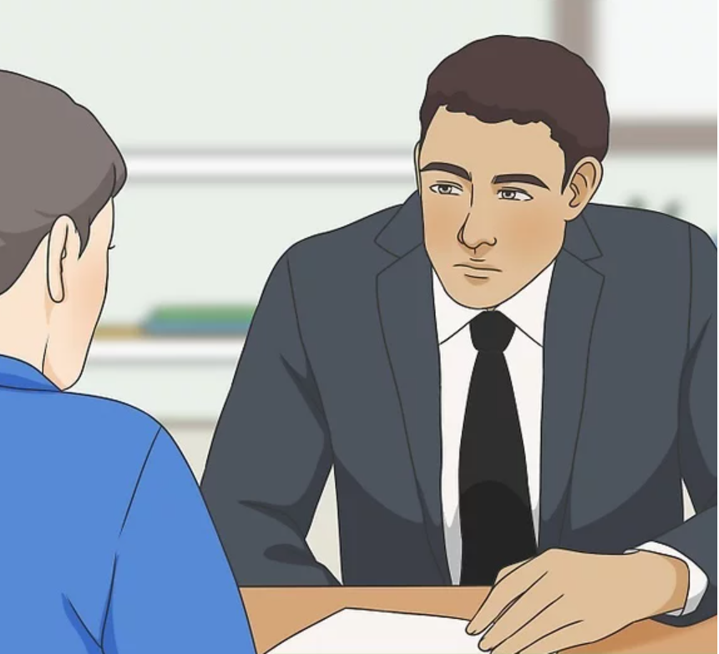
If You are Accused of Harassment
Remain calm
Do not confront your accuser
Write down what happened.
Notes:
Harassment accusations can be very stressful and may cause the accused to immediately go into ‘defensive’ mode. While this may feel like the right thing to do at the time, in the end it will not be productive. Ignoring the situation will not make it go away, so the best way to deal with it is to face it head-on.
Just as the accuser has the right to consult with the proper authorities, the accused does as well. This will be the opportunity for them to explain their side of the story and if it is determined that the accused is innocent, put an end to the matter. However, if the accused is found to be guilty, the appropriate steps will be taken to discipline the offender and protect the victim.
If you have been accused of workplace harassment:
Remain calm: If you are accused of workplace harassment, remain calm and listen to what your accuser is saying
Do not confront your accuser: Keep your thoughts to yourself; your words may be misconstrued
Write down what you need to say: Document your account of what is said to have happened.
Go to your direct supervisor: Recount what has happened, bringing with you whatever notes you have prepared.
NOTE: The victim of harassment does not necessarily have to be the person being harassed; anyone affected by the behavior is considered a victim.

Slide 36
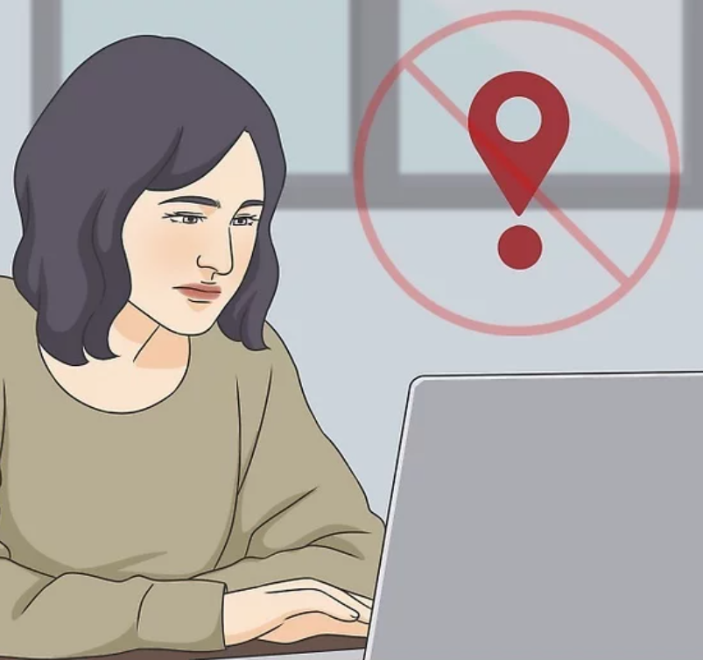
Confidentiality
Strict adherence to confidentiality is crucial in the case of an actual, or perceived harassment situation.
Notes:
Strict adherence to confidentiality is crucial in the case of an actual, or perceived harassment situation. The highest degree of confidentiality possible is necessary in order to properly conduct the investigation, protect the parties involved, and maintain control over the entire situation.
One thing that is important to remember is that, although every possible measure will be taken, it is not possible to promise complete confidentiality. In order to conduct a proper investigation, some details of the case must be exposed to key people who are involved in the investigation, but it is reasonable to ensure the parties involved that everything will be done to prevent non-crucial personnel from having access to the case file.

Slide 37
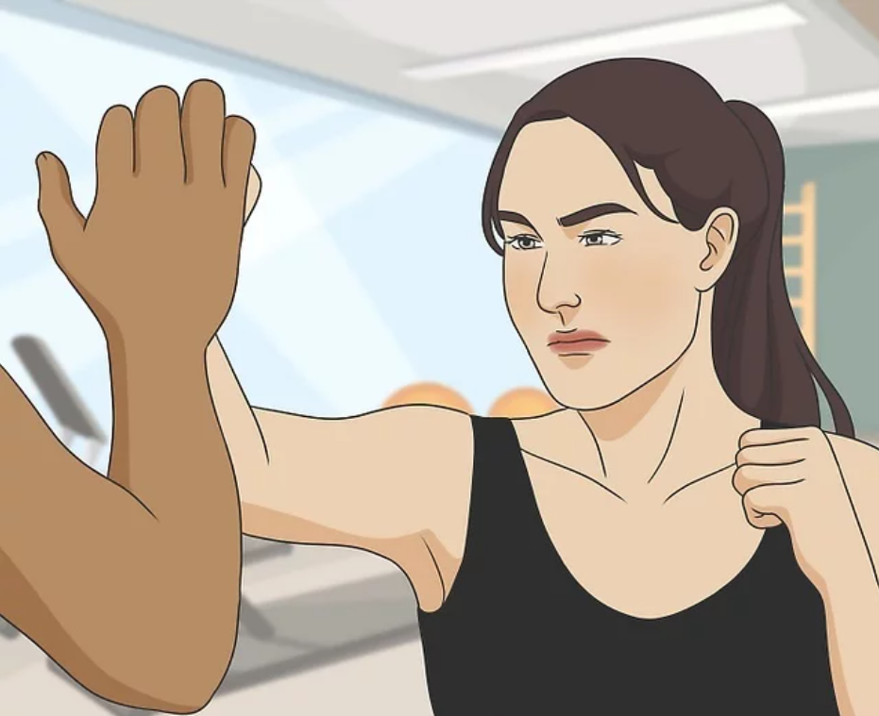
Retaliation
Employees who file a complaint about workplace discrimination or harassment are protected from retaliation by Federal Law.
Notes:
Employees who file a complaint about workplace discrimination or harassment are protected under federal law as long as the complaint was made in good faith. This is true even if the claim turns out to be unfounded.

Slide 38
Review
How to Address the Situation
If You are Being Harassed
If You are Accused of Harassment
Confidentiality
Retaliation
Notes:
Jean was devastated. She was being falsely accused of harassing another individual in their office, and it was taxing on her emotions. Jean did not want to come across as hostile by confronting this individual, so she returned to the Human Resource office to chat with May, the HR representative. May explained that it is an active and confidential case, and that they will make sure they gather all of the information from both sides. May continued to say that the best way to confront any allegation was to go through the correct chain of command, in which Jean could plead her case, and be given the opportunity to declare her innocence with proper authority.
With this information from May, Jean felt some relief. She was glad that this case would be confidential, and that non-crucial personnel would be prevented from having access to the case file. She knew she would be able to explain her side of the story, to fight this false allegation.
________________________________________
James and Sara were recently in a heated disagreement, which led to James making inappropriate comments about Sara. Feeling uncomfortable and victimized from this disagreement, Sara knew that she had to consult with the proper authority to document this incident. She approached Sam, the HR representative in their office, and discussed the matter with him. Sam listened, and informed Sara of the proper procedures that are done to file a claim, including gathering personal information about Sara, a description of the incident, and why she believed she was being discriminated against.
After this initial consultation, James was informed about what was happening, and began to worry. He did not think that he was harassing Sara, but knew he had to remain calm. He could not become defensive or ignore the situation. Rather, he had to face the situation head on. James began to write down what he believed happened, to have as documentation for when he would speak with HR. This way, they were both able to explain their sides of the story.

Slide 39
3a. In cases of harassment, what actions may be taken?
A. Charges filed
B. Suspension due to the action
C. Termination due to the action
D. All of the above
Notes:
D. In cases of extreme harassment, actions such as demotion, suspension, or termination could be necessary. Charges may be filed.

Slide 40
3b. When someone is harassed or accused of harassing someone else, what is vital in order for the investigative process to go smoothly?
A. That all involved follow the proper procedures
B. That all involved go the highest level to have the problem resolved
C. That all involved have patience while the problem is worked out
D. That all involved immediately read the policies posted around the office
Notes:
A. It is important to consult with the proper authority (e.g., Supervisor, Human Resources, Manager) so they can document the incident and make sure all other points outlined within the policy are being followed.

Slide 41
3c. Why must the offender understand that their actions are hurtful, inappropriate, and not tolerated in the workplace?
A. Because only then can the ruling in their case change
B. Because the number of mediations needs to decrease
C. Because continued illegal actions can result in dire consequences
D. Because it is the only way to move beyond the harassment
Notes:
C. They may not consider the disciplinary action they were dealt for their actions as severe, but if their inappropriate behavior continues, they may be faced with dire consequences.

Slide 42
When is confidentiality crucial?
A. At all times in the workplace regardless of circumstance
B. In an alleged case of harassment
C. In a case of harassment
D. In a case of harassment, or perceived harassment
Notes:
D. Strict adherence to confidentiality is crucial in the case of an actual, or perceived harassment situation.

Slide 43
4. Who is responsible for monitoring the process of addressing an incident of harassment and the work environment after the conclusion of the incident?
A. Designated personnel of the company
B. The employee harassed
C. The person accused of harassment
D. All of the above
Notes:
D. Designated personnel within the company are assigned to monitor the process of addressing the harassment issue after its conclusion, the people involved should monitor the situation to some extent.

Slide 44
Building a Respectful Workplace
Part 4
Once respect is present, all employees should be empowered to maintain this respect in order to ensure a healthy, successful workplace each day.
Notes:
Practicing respect will lead to a stronger team that works collaboratively, creating a safe work environment in which employees feel valued and secured.
A respectful workplace does not just happen on its own; it is built. It is common for a workplace to develop disrespectful practices unintentionally, thus it is important to be conscious of our actions in order to build this respectful environment where employees spend most of their day. Once respect is present, all employees should be empowered to maintain this respect in order to ensure a healthy, successful workplace each day.
When employees are not respected, it has an immense impact on their job performance. Respect is not only the right thing to do, but it has many great benefits that will be discussed in this module.
Practicing respect will lead to a stronger team that works collaboratively, creating a safe work environment in which employees feel valued and secured. Respect will only have positive outcomes, so it is critical to practice these behaviors in order to achieve the following benefits.

Slide 45
It Starts With You
Being a respectful employee requires self-respect, respect for the people around you, and respect for the environment around you.
Notes:
A respectful employee presents with special behaviors and skills. While modeling the behaviors themselves, they are influencing the people around them. Being a respectful employee requires self-respect, respect for the people around you, and respect for the environment around you.
A respectful employee will acquire:
Active listening and communication skills
Organizational and time management skills
Leadership skills
Self-motivation
Problem-solving skills
Teamwork skills
Respectful employees understand and accept that they will not always be right. They listen to what other people have to say, and do not disregard the feelings of others. They recognize the valuable qualities of others. Respect requires being honest and telling the truth while maintaining care for the people around you. Employees should always support their leaders and workplace, and strive to reach goals that will help them to become the best employee they can be. Always keep in mind that behaving in a respectful manner will show a reflection of your character.
Creating a respectful environment can be as simple as greeting your coworkers, holding open the door for another, using names when addressing one another, or saying please and thank-you. These manners can go a long way in the promotion of a healthy workspace, and will influence others to share this respect with others.
You can also help build a respectful workplace by showing consideration to the business itself. This can include showing up on time for your job, staying for the scheduled shift, helping others out at work, and doing your very best in your work performance.

Slide 46
The Importance of Mutual Respect
Respect is a two-way street; a respectful work environment requires reciprocal respect among the employees.
Notes:
Respect is a two-way street; a respectful work environment requires reciprocal respect among the employees. The first step in ensuring mutual respect is to understand that you are all part of the same team, working towards similar goals. Mutual respect works when employees know that they are all entitled to an equal voice, and that it is more advantageous to work with one another, rather than for one another.
Employees who share mutual respect understand proper problem solving. Rather than fighting over issues, they will constructively discuss the problem, find common ground and come up with a proper solution. Any disrespectful behavior should be addressed and corrected immediately. Mutual respect will create a more positive work environment, and allow for better job satisfaction.

Slide 47
Earning Respect
Focus on your surroundings
Be inclusive, and understand workplace diversity
Be truthful, and admit any faults
Notes:
If you wish to earn respect, you must be worthy of gaining respect. You cannot earn respect if you do not show respect for yourself, or for those around you. The key to earning respect is to think of others, pay attention to the people around you, and help those who require assistance. Thus, earning respect is the result of giving respect to others. A respectful individual does not belittle those whom they feel have less power.
Here are some ways in which we can earn respect, by giving respect:
Honor the promises that you have given
If you respect other people’s time, they will show respect for yours in return
Focus on your surroundings
Be inclusive, and understand workplace diversity
Be truthful, and admit any faults
Truly care for others
Offer help when needed
Stay open-minded. Understand that you still have a lot to learn, and everyone shares different knowledge
We can earn respect from others in many ways. Start by being proactive, and using your skills and resources to achieve positive actions. Remember that these actions can be more powerful than words.

Slide 48
Diversity vs. Inclusion
Respectful practices will help to accomplish inclusion and diversity to create a powerful team in the workplace.
Notes:
Diversity and Inclusion are terms that are frequently linked together; however, they carry different meanings. Practicing respectful behaviors is the key to achieving a healthy, diverse workplace in which every employee is acknowledged and appreciated.
Diversity: The term diversity refers to the similarities and differences between humans. This includes race, gender, age, socioeconomic status, or religion.
Inclusion: The term inclusion refers to the actions that are taken to accommodate diversity. Inclusion is the “how”, or rather, what is done in order to include everyone.
Respectful practices will help to accomplish inclusion and diversity to create a powerful team in the workplace.

Slide 49
Team Contribution
Respect is contagious; when we show respect for others, we will in turn receive and earn respect from others.
Notes:
Respect is contagious; when we show respect for others, we will in turn receive and earn respect from others. Thus, mutual respect is a team contribution.
When everyone is working together, and respecting ideas and contributions from one another, great things can happen. This includes, determining the goals for the team, including every employee in this process, and establishing the strengths and weaknesses of each team member. We can start with modeling respectful behaviors ourselves, but in order to create a powerful, productive workplace, it requires respectful efforts from the overall team.

Slide 50
Respecting Space and Boundaries
Asking to borrow items from one another
Respecting privacy by not eavesdropping
Listening to verbal cues
Recognizing body language
Ensuring that communication is clear
Notes:
Understanding and respecting personal space and boundaries is an essential factor in creating a safe work environment, and helps to define our personal responsibilities and values.
Personal space is the physical distance between two or more individuals, within a family, at work, or in any social environment. This physical distance will vary however, depending on your comfort and relationship with the other person.
We all have different boundary expectations, so that is why it is critical to recognize cues and any indications when we may have disrespected another individual’s boundaries. Violations to space and boundaries may be accidental, or on purpose. The workplace should be a safe zone; in order to respect the space and boundaries of others, it is important to ensure we are able to distinguish when we are invading other’s personal space, and how to correct these violations.
In the workplace, we can respect other employee’s space and boundaries by:
Asking to borrow items from one another, rather than just assuming that you can enter their space to take this item
Respecting privacy by not eavesdropping, or minding your own business from other conversations
Listening to verbal cues, such as discrete changing of the subject throughout the conversation, or statements that entail that they are being invaded, such as “I am uncomfortable with you doing that.”
Recognizing body language, such as taking steps back, or folding of the arms
Avoiding all sensitive topics, or any topics that are inappropriate or personal at work
Ensuring that communication is clear, and that you are fully listening to what others are saying

Slide 51
Workplace Ethics
Ethics are the moral principles that motivate our behaviors and choices; guiding us to abide by right and wrong conduct.
Notes:
Ethics are the moral principles that motivate our behaviors and choices; guiding us to abide by right and wrong conduct. Ethics and respect coincide with one another.
Respect helps to give the principles of ethics meaning. Workplace ethics are the rules and guidelines established in a workplace that dictate proper actions and behaviors.

Slide 52
Enhancing Professionalism
There is a strong link between respect and professionalism; you cannot be considered professional if you lack respect.
Notes:
Simply put, a professional employee is one who displays respect in their everyday work performance. There is a strong link between respect and professionalism; you cannot be considered professional if you lack respect.
It is a professional obligation in the workplace to show consideration for your fellow employees, respect differences between individuals, and care for the rules and regulations of the company. As employees, you are expected to have a high level of professionalism, which can be enhanced by continuing respectful practices each day.

Slide 53
BENEFITS
Productivity and Knowledge
Employees who trust and share mutual respect are more likely to share knowledge with each other.
Job Satisfaction
Respect for one another will lead to employees feeling satisfied, content, and empowered to contribute to decisions in the workplace.
Employee Engagement
A respectful workplace is one in which employees are more likely to apply themselves, such as in decision-making.
Welcoming Environment
A successful workplace is one in which there is a sense of fairness amongst everyone.
Notes:
Employees who trust and share mutual respect are more likely to share knowledge with each other. This allows the employees to work as a cohesive team, rather than trying to excel over one another. Every individual should feel as though their intelligence is of great significance to the team, and should want to contribute to the conversation.
When respect is present, everyone will be motivated to do better. There is a better understanding of the expectations and responsibilities of each individual. Any controversy in the office that is addressed respectfully and professionally will help to increase productivity, by reducing the amount of time spent in dispute.
A respectful workplace is one in which employees are more likely to apply themselves, such as in decision-making. Employee engagement includes both engagement with the manager and with other employees. When employees see how they fit into the business, and their overall role for the team, they will feel more enthusiastic about their work. Employees who are disengaged in their work are more likely to leave their job.
Respect for one another will lead to employees feeling satisfied, content, and empowered to contribute to decisions in the workplace. If an employee is feeling valued for their efforts, they will feel comfort and stability with their team, resulting in a better work-life balance.
Employees who do not feel respected in the workplace will be less committed to their positions. Satisfied employees will help the company to grow. Respectful practices are beneficial to the employees as individuals, and the workplace as a whole. When respect is present, everyone benefits!
Work can occasionally be a main source of stress; each day we have deadlines, goals, and the desire to be promoted. Stress is the body’s response to changes or demands. Stress is not always a negative response, since it helps us to meet challenges. However, it is when demands become completely out of our control that stress can take over and harm us both physically and mentally. Stress can be associated with many concerning health effects, such as heart attack, or hypertension.
In general, a respectful environment is a welcoming environment. This includes employees feeling both happy, and healthy. Respect will reduce workplace hardships, and increase employee attendance. A successful workplace is one in which there is a sense of fairness amongst everyone. Employees wish to feel safe in their work environment, and this will be accomplished when we respect each other.

Slide 54
Practical Illustration
It starts with you
Team Contribution
Respecting Space
Workplace Ethics
Benefits
Notes:
Dmitri and David have worked side by side at a company for the past five years. David has been noticing that Dmitri has been getting more comfortable with helping himself to the belongings on his desk, and is always interrogating David about his home life. David felt as though Dmitri was more interested in talking rather than working, and wanted Dmitri to give him some space so that he can get his work done.
David was uncertain about how to ask Dmitri to respect his personal space and boundaries. Fortunately, the company held a meeting that had discussed how to appropriately approach others in the workplace, and how to recognize signs that you are invading the personal space of others. It was mentioned to look at different cues and gestures, and what not to talk about at work. Dmitri thought to himself, “Hey, that sort of sounds like me. Am I invading David’s space? These gestures sound like the way that David would act when I would chat with him.” After this, Dmitri focused on ensuring that he was respecting David’s space and boundaries. This created a better partnership between the two workers.
____________________________________________
Joyce has recently started her new job at a new office as a bookkeeper. She is very excited for this new beginning, since she has heard great things about this office. In her first week, she knew she had made the right decision to join this team. At her old workplace, the employees did not communicate, discuss ideas, or truly care for each other. She had felt unnoticed and undervalued. Since starting her new job, Joyce has been much happier and healthier. She is able to engage with her coworkers, share her strengths, and truly feels as though her voice is heard. “Wow”, thought Joyce. “It’s so nice to be able to be a part of a team, in such a welcoming environment!”
Arthur has just recently started a new job as an accountant. He wanted to start fresh in this new office, being someone who the rest of the team admires, and turns to for help. In his first week, Arthur had demonstrated time management, organization, problem solving, and a variety of other skills that model a respectful employee. He was proud of himself for putting in such a great effort during his first week, and the management team observed this exceptional behavior. The management team knew that they had made a great choice in the hiring of Arthur, and Arthur knew that he had made the right choice in choosing to be an employee who respects himself, as well as his team.

Slide 55
4a. Why must we be conscious of our actions in the workplace?
A. It is not necessary to be conscious of our actions
B. To ensure we are more respected than those around us
C. To ensure a respectful environment and avoid unintentional disrespectful practices
D. To prove we are better than fellow employees
Notes:
C. Our actions will help to build a respectful work environment and avoid unintentional disrespectful practices.

Slide 56
4b. In general, a respectful environment is __________.
A. A quiet environment
B. A welcoming environment
C. A boring environment
D. Unproductive
Notes:
B. A respectful environment is a welcoming environment.

Slide 57
4c. What are some simple gestures we can do to create a respectful environment?
A. Greet your coworkers
B. Hold the door open for another employee
C. Use names when addressing the employee
D. All of the above
Notes:
D. These are all simple gestures that can be incorporated into our everyday work lives.

Slide 58
4d. How can being vigilant in one’s interactions with others help?
A. It can help avoid ambiguous circumstances that may be considered harassment
B. It will look good in your file
C. It can help resolve cases of harassment positively
D. It will ensure cases of harassment never arise
Notes:
A. Being vigilant in one’s interactions with others can help avoid ambiguous circumstances.

Slide 59
4e. Which of the following can disrespectful behavior in the workplace cause?
A. Stress and anxiety
B. Lower productivity
C. Long term health issues
D. All of the above
Notes:
D. Disrespectful behaviors such as bullying or harassment can lead to long term health issues. The victim could have decreased satisfaction, loss of sleep, lower productivity, stress and anxiety.

Slide 60
Wrapping Up
CONCLUSION
Although this workshop is coming to a close, we hope that your journey to improve your Respect in the Workplace skills is just beginning.
Notes:
Although this workshop is coming to a close, we hope that your journey to improve your Respect in the Workplace skills is just beginning.
We wish you the best of luck on the rest of your travels.

Slide 61
Words From the Wise
Disagreement is one thing; disrespect is another.
- Richard V. Reeves
Diversity: the art of thinking independently together.
- Malcolm Forbes
Respect other people’s feelings. It might mean nothing to you, but it could mean everything to them.
- Roy T. Bennett
I’m not concerned with your liking or disliking me… All I ask is that you respect me as a human being.
- Jackie Robinson
One man can make a difference, and every man should try.
- John F. Kennedy
Victory is always possible for the person who refuses to stop fighting.
- Napoleon Hill
We must learn to live together as brothers or perish together as fools.
- Dr. Martin Luther King, Jr.

