Slide 1
+
MILLE LACS BAND
OJIBWE ROSETTA STONE PROJECT
Harnessing the Mille Lacs Band’s language experts and Rosetta Stone’s technology to revitalize and preserve the Ojibwe Language

Slide 2
Overview
The Mille Lacs Band of Ojibwe (MLBO), a sovereign and federally recognized American Indian tribe, partnered with Rosetta Stone’s Endangered Languages Program (ELP), to record and preserve the Ojibwe language and Mille Lacs dialect.
Through the initiative, the Mille Lacs Band and ELP have utilized tribal members' knowledge and authentic cultural resources to create a comprehensive set of Rosetta Stone lessons in Ojibwe.
The lessons feature Ojibwe community members, videos and illustrations that teach vocabulary and grammar in an engaging and effective way.
Rosetta Stone’s speech recognition engine, TruAccent, compares learners' pronunciation to that of native Ojibwe speakers to help students fine-tune their skills.
Learners can access lessons anytime, anywhere on desktop computers or Apple and Android mobile devices.
Rosetta Stone Ojibwe is designed to reflect our Ojibwe culture, because our language and our culture go hand in hand.

Slide 3
Notes:
This is Bella’s video. It will need internet to play. It might take a second to load.

Slide 4
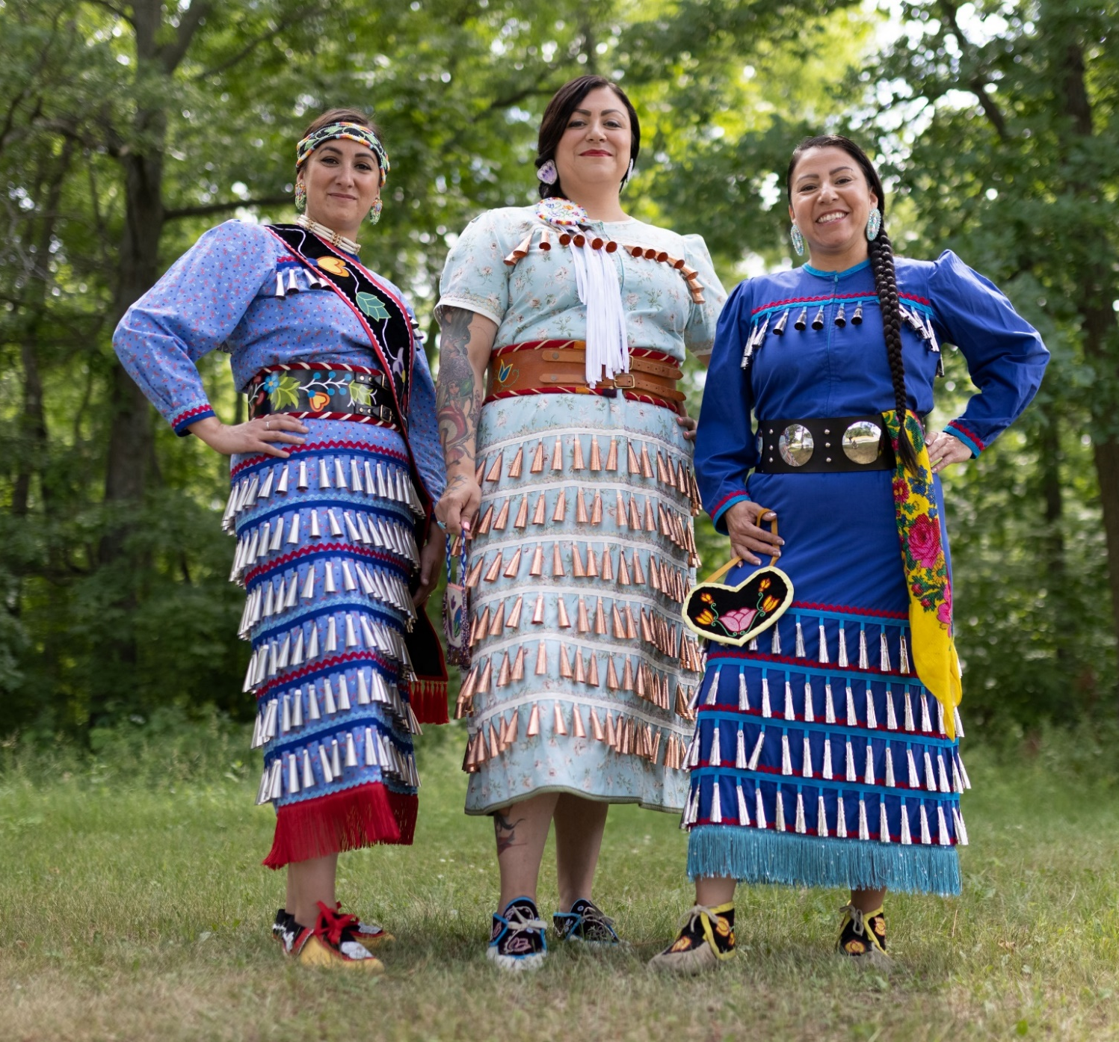
About
this
project
Notes:
Bebiskaneyaashiikwe Wendy Merrill Amikogaabawiikwe Adrienne Benjamin Anangookwe Darcy Big Bear

Slide 5
“As Anishinaabe people, our language was given to us by the creator; learning that language helps us connect with our culture and live our lives in a good way.”
Mille Lacs Band Chief Executive
Melanie Benjamin

Slide 6
Background
The Mille Lacs Band of Ojibwe’s roots in Minnesota date back to the mid-1700s when it established itself in the region around Mille Lacs Lake.
Throughout the next century, non-Indian settlers expanded west and attempted to remove tribal members from the lands they had occupied for generations.
As generations of Mille Lacs Band members were deprived of their cultural identity, the Ojibwe language became critically endangered.
As part of the Band's commitment to revitalizing the language, educating the public about Ojibwe culture, and providing holistic support to its members, the Mille Lacs Band collaborated with Rosetta Stone to develop Ojibwe language learning lessons.

Slide 7
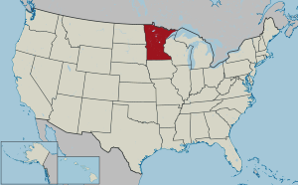
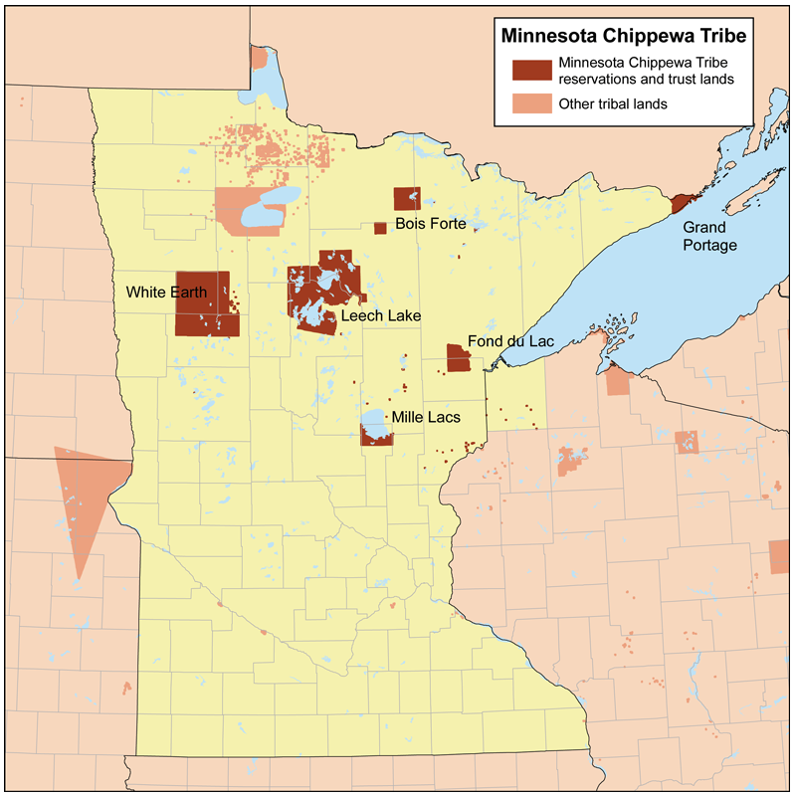
About the Non-Removable Mille Lacs Band of Ojibwe
The Mille Lacs Reservation is located in east-central Minnesota and is the perpetual home of the Non-Removable Mille Lacs Band of Ojibwe.
More than 2,300 of the Band’s 4,700 members live within reservation boundaries.
Notes:
The Band supports its members with a variety of services for economic, social, and cultural advancement, including health services, early childhood and youth centers, and economic development planning.

Slide 8
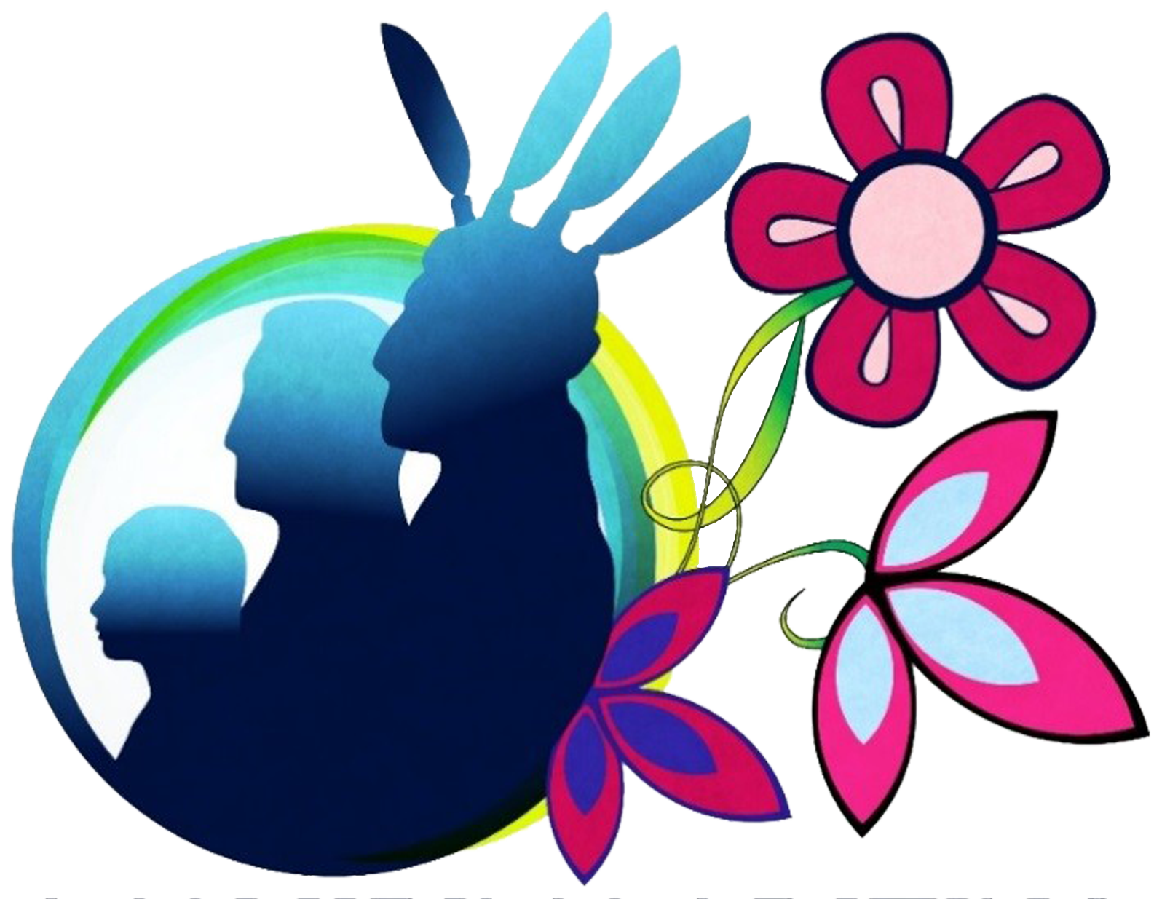
About Aanjibimaadizing
This program provides services to Tribal members seeking to establish self-sufficiency for themselves and their families in accordance with Public Law 102-477.
The goals of the program are centered on our mission statement:
To assist our fellow Anishinaabe with education, training, work experiences, cultural participation, and support services to be prosperous and change their life.
Aanjibimaadizing is a work force service organization that helps to empower participants with an acquired purpose or occupation that will contribute to the well-being of their community and family.
Our services support obtaining and retaining employment, improving or creating a position of job readiness, and addressing barriers that prevent our clients from leading their best life.
Aanjibimaadizing, which means “changing lives” in our Ojibwe language, is operated as a division of the Mille Lacs Band’s Department of Administration.
Notes:
...Through this, we are able to offer services to a large percentage of our community and work closely with other organizations to help all ages embrace their culture and overcome barriers to sustainability.
Users can sign up through Aanjibimaadizing, a division of the Mille Lacs Band's Department of Administration.

Slide 9
Some of the Ways Language Contributes to Economic Development
Promotes
Cultural values and heritage
Traits that develop social capital
Individual motivation
Lower rates of incarceration
Less violence
Lower rates of substance misuse
Equity & Diversity
Peace building
Social inclusiveness
Literacy
Language &Culture
Enables
More effective development interventions
Reduced health issues
Stability
Self-sustainability
Sustainable development
Reconciliation
Results In
Positive boost in the way a community learns, interacts and develops
Economic benefits
Poverty reduction
Non-monetized benefits
Unique systems of knowledge and understanding
Fundamental human rights and freedoms for indigenous peoples
Notes:
The Department of Economic and Social Affairs of the United Nations includes culture as a significant driver and an enabler of sustainable development:
“…Statistics, indicators and data on the cultural sector, as well as operational activities have underscored that culture can be a powerful driver for development, with community-wide social, economic and environmental impacts.
Of particular relevance is the cultural sector’s contribution to the economy and poverty alleviation.”
“Culture-led development also includes a range of non-monetized benefits, such as greater social inclusiveness and rootedness, resilience, innovation, creativity and entrepreneurship for individuals and communities, and the use of local resources, skills, and knowledge. Respecting and supporting cultural expressions contribute to strengthening the social capital of a community and fosters trust in public institutions. Cultural factors also influence lifestyles, individual behaviour, consumption patterns, values related to environmental stewardship, and our interaction with the natural environment. Local and indigenous knowledge systems and environmental management practices provide valuable insight and tools for tackling ecological challenges, preventing biodiversity loss, reducing land degradation, and mitigating the effects of climate change.”
Also, “Cultural heritage, cultural and creative industries, sustainable cultural tourism, and cultural infrastructure can serve as strategic tools for revenue generation,” particularly in developing communities with a rich cultural heritage.
Source - https://www.un.org/millenniumgoals/pdf/Think%20Pieces/2_culture.pdf

Slide 10
OJIBWE LANGUAGE AND CULTURE REVITALIZATION
Native languages are more than just words, as cultural values, tribal customs, and ceremony are embedded in them. Additionally, Indigenous languages serve as protective factors for Indigenous communities.
Worldwide, improved education and employment outcomes and greater life satisfaction have been linked to identifying and engaging in Indigenous cultural activities.
Studies demonstrate that people who speak their Native language(s) have enhanced mental health and happiness, measured by lower rates of suicide, suicide attempts, and suicidal ideation than those without language knowledge.
In many communities around the world, native languages are dying at an alarming rate. The effects of colonization and assimilation have taken their toll on the number of native language speakers and socioeconomic conditions have not made the task of retaining languages any easier. As time goes on, revitalization efforts become increasingly difficult.
Notes:
This is especially true for at-risk adults and youth who have experienced the negative impacts of substance misuse, mental health issues, violence, chronic unemployment or incarceration.

Slide 11
OJIBWE LANGUAGE AND CULTURE STRATEGIC GOALS FOR 2021-2024
1. Preserve our endangered language by normalizing Ojibwe Language and cultural use in the community.
2. Support workforce development by creating life-long Ojibwe language learning opportunities.
3. Support development of client self-esteem, pride in identity and wellness that contributes to workforce readiness by offering life-long Ojibwe language and culture learning opportunities.
4. Support youth substance abuse prevention and support clients struggling with addiction or recovery as a barrier to employment through a language/culture program that promotes the daily use of Ojibwe language and expanded cultural as a means of improving self-esteem, pride in identity and workforce readiness.

Slide 12
Rosetta Stone is dedicated to changing lives through the power of language education.
The company’s immersive learning experiences help people build fluency in 25 languages at home, in schools, and in workplaces around the world.
The platform’s Dynamic Immersion method allows users to learn quickly and intuitively, and advanced speech recognition technology helps perfect their pronunciation.
Through Rosetta Stone, learners develop the skills and confidence to communicate and make deeper connections with people from all walks of life.
Notes:
Rosetta Stone joined the IXL Learning family of brands in 2021.

Slide 13
Endangered Languages Program
Across the globe, children in countless cultures are losing the languages of their parents and grandparents.
In fact, as many as 50 to 90 percent of the world's 6,800 languages may be extinct within this century.
As each new generation becomes more isolated from its past, ancestral languages slip further out of reach.
To stem this loss of knowledge, the Rosetta Stone Endangered Languages Program works with Indigenous groups to preserve cultural assets with software that is specifically designed to revitalize at-risk languages.

Slide 14
"We often think of languages as what we speak or write, but overlook how they provide priceless insight into cultures. Indigenous languages are becoming endangered at an alarming rate, and many Native Americans are at risk of losing a vital part of their heritage. Our collaboration with the Mille Lacs Band of Ojibwe has created resources that support the revitalization of the tribe’s language, help pass down knowledge to the next generation of members and expose the wider public to the Band’s rich culture.”
Paul Mishkin, CEO of IXL Learning, Rosetta Stone’s parent company.

Slide 15
Data & Statistics
Notes:
Bebiskaneyaashiikwe Wendy Merrill Amikogaabawiikwe Adrienne Benjamin Anangookwe Darcy Big Bear

Slide 16
Tribal Enrollment Status
16% of users are Mille Lacs Band of Ojibwe members or descendants
78% of users are enrolled in other tribes
6% are others that are not enrolled

Slide 17
These licenses have been purchased by people from more than 131 tribes throughout the United States and Canada. These tribes reach from coast to coast and from the Hudson Bay to the Mexico boarder. Most of these are in the Great Lakes Area, as would be expected.
Notes:
(With this map generator, the black dot of the pin, not the point of the pin, is the location of the headquarters for each tribe. Where this matters most is: there were no tribes with a Mexico address and the tribe from Nova Scotia is not located in the Atlantic Ocean.)

Slide 18
Some of the Tribes Represented in Previous Slide:
Alderville First Nation | Grand Portage Band of Ojibwe | Michipicoten First Nation | Shawanaga First Nation
Algonquins of Pikwàkanagàn First Nation | Grand Traverse Band | Mille Lacs Band of Ojibwe | Sisseton-Wahpeton Oyate Lake Traverse
Bad River Band of Lake Superior Chippewa | Grassy Narrows Ontario Canada | Moravian of the Thames | Six Nation First Nation
Bay Mills Indian Community | Hannahville Indian Community | Naknek Native Village | Sokaogon Chippewa Community
Beausoleil First Nation | Ho-Chunk Nation | Naotkamegwanning First Nation | Spirit Lake
Blackfeet Tribe | Indian Mills | Native Villiage of Afognak | St. Croix Chippewa Indians of Wisconsin
Boise Fort Band of Ojibwe | Keweenaw Bay Indian Community | Navajo | Standing Rock Sioux Tribe
Brunswick house first nation | Lac Courte Oreilles | Northern Arapaho Tribe | Stockbridge Munsee Community
Central Council of the Tlingit & Haida | Lac du Flambeau Band | Nottawaseppi Huron Band | Thono o Odham
Cherokee Nation | Lac Seul First Nation | Oglala Sioux Tribe | Fort Berthold Reservation
Cheyenne River Indian Reservation | Lac Vieux Desert band | Ojibway's of Onigaming | Timiskaming First Nation
Chicksaw Nation | Lake Manitoba First Nation | Ojibways of the Pic River First Nation | Tonawanda Band of Seneca
Chippewas of Nawash Unceded First Nation | Lake Micmac | Oneida Tribe of Indians | Turtle Mountain Band of Chippewa Indians
Chippewas of the Thames First Nation | Leech Lake | Ottawa Tribe of Oklahoma | Upper Skagit
Choctaw Nation | Little River Band of Ottawa Indians | Peguis First Nation | Wabigoon Lake Ojibway Nation
Citizen Potawatomi Nation | Little Shell Tribe of Chippewa Indians | Ponca | Walpole Island First Nation
Couchiching First Nation | Little Traverse Bay Bands of Odawa Indians | Prairie Band Potawatomi Nation | Wasauksing First Nation
Crow Tribe of Montana | Long plain First Nation | Rainy River First Nation | Weenusk First Nation
Dokis First Nation | Longlake 58 First Nation | Rama First Nation | White Earth Band
Eastern Band Cherokee | Lower Brule Sioux | Red Cliff | Whitefish River First Nation
Fon-Du-Lac Band of Ojibwe | M'Chigeeng First Nation | Red Lake Band of Chippewa Indians | Whitesand First Nation
Forst Apache Reservation | Mdewakanton Sioux | Sagamok Anishnawbek First Nation | Wikwemikong Unceded Indian Reserve
Fort Belknap Reservation of Montana | Menominee Indian Tribe | Saginaw Chippewa Indian Tribe | Winnebago Tribe
Fort Peck Assiniboine | Meskwaki | San Carlos Apache Tribe | York
Garden River First Nation, Ontario Canada | Metis Nation of Ontario | Sault Ste Marie Tribe of Chippewa Indians
Gila River Indian Community | METIS Red River and Southbranch | Serpent River First Nation
Notes:
If you don’t see your

Slide 19
% MLBO Members & FIRST Descendants
% MLBO Members by District

Slide 20
Age Range of Users
The ages of those using our Ojibwe Rosetta Stone are fairly evenly distributed.
The 35-44 age group is the largest, but only slightly.
Average age is 39.7 years
Top age is 86 years!
Notes:
A challenge we were expected (and prepared for) is that elders might have a more difficult time accessing and using the technology piece of the Mille Lacs Band of Ojibwe Rosetta Stone.
With the 55+ age bracket just below the largest age group in participation, it seems we have navigated this challenge well… and it shows just how amazing our Ojibwe elders are!

Slide 21
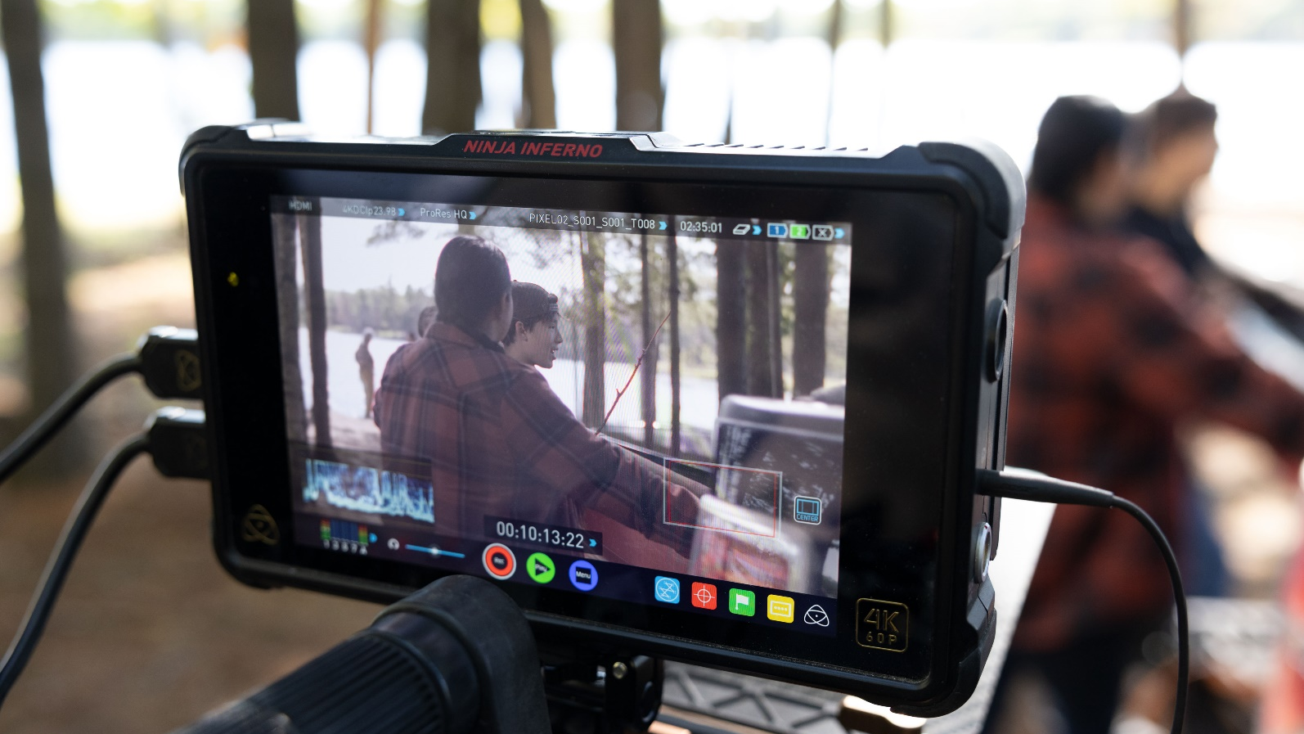
6,287 licenses have been assigned
Over 44 jobs have been created related to this project
Over 39,104 hours have been spent learning Ojibwe
(that’s almost 4 ½ years!)
Notes:
Licenses have also been purchased that have yet to be assigned by the purchasing organization. (about 3,000 haven’t been assigned)

Slide 22
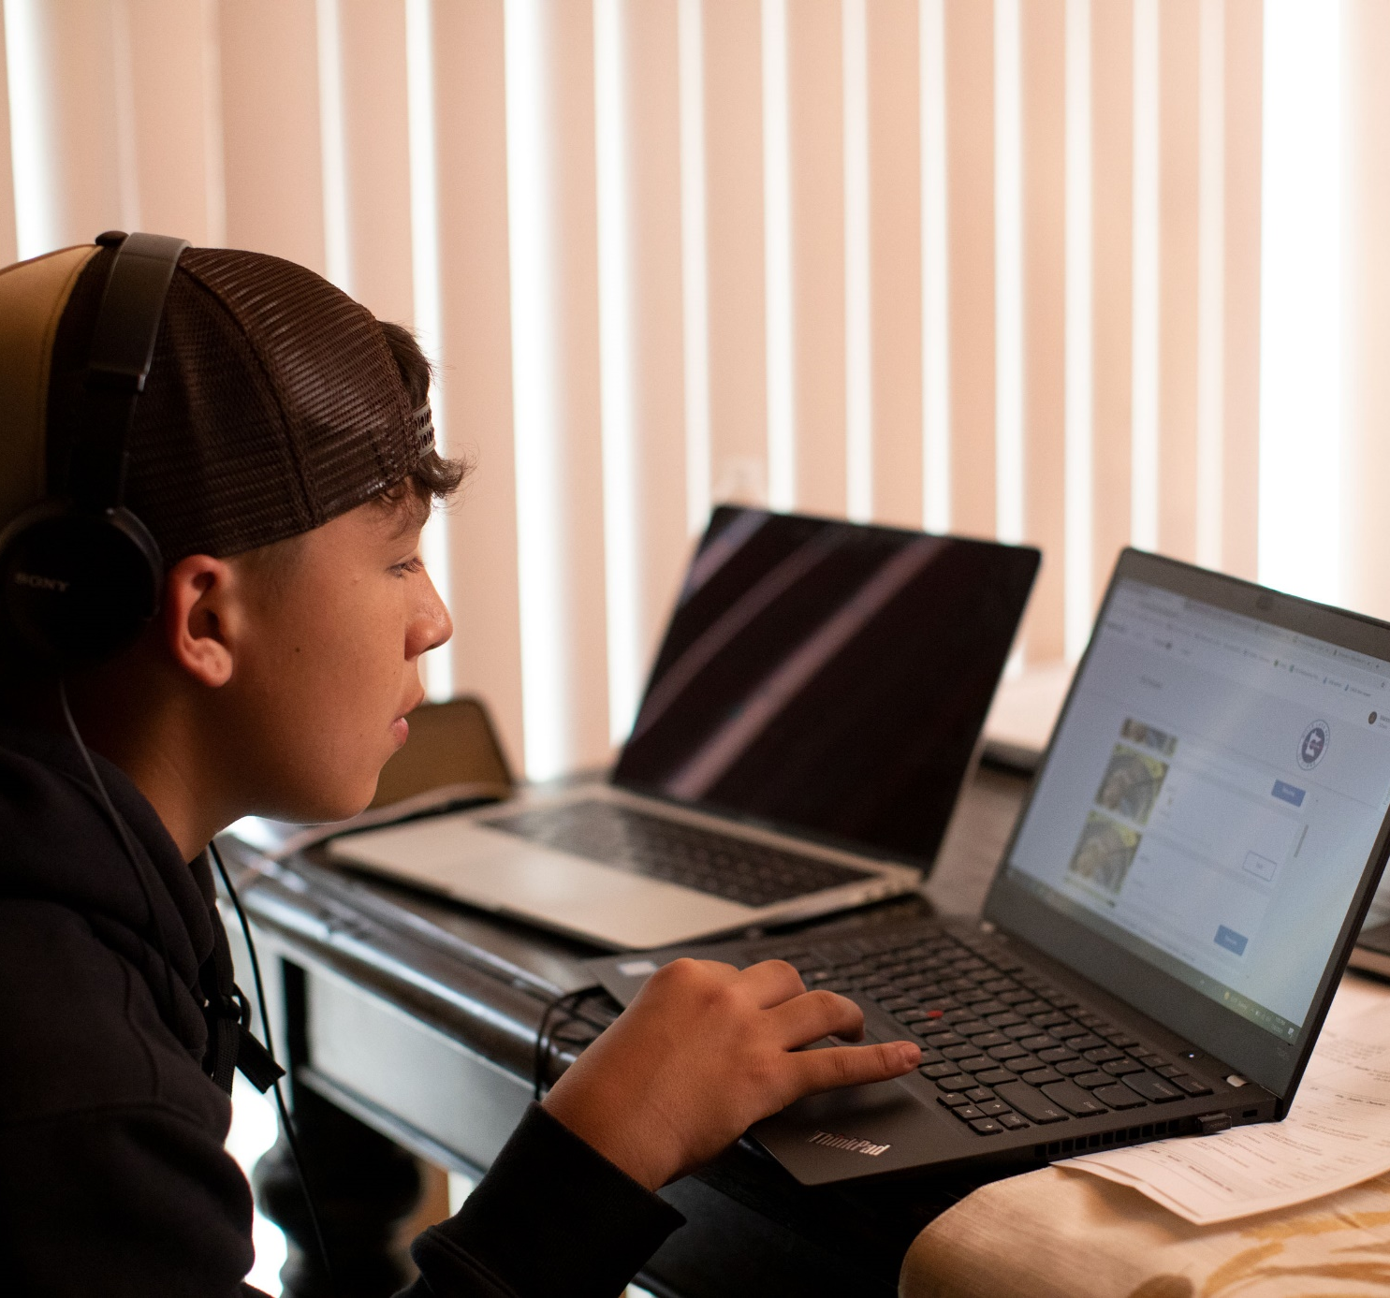
How to register
Notes:
Bebiskaneyaashiikwe Wendy Merrill Amikogaabawiikwe Adrienne Benjamin Anangookwe Darcy Big Bear

Slide 23
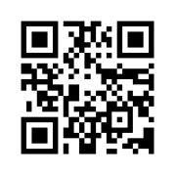
How to Register
Users can sign up through Aanjibimaadizing, a division of the Mille Lacs Band's Department of Administration at https://culture.aanji.org/.
Notes:
Users can sign up through Aanjibimaadizing, a division of the Mille Lacs Band's Department of Administration.

Slide 24
Cost
While it is agreed that the Ojibwe Language is a gift that enriches the lives of our communities, small fees have been included for outside entities. This is intended to help recuperate developmental costs and administrative expenses that will be incurred by the Mille Lacs Band of Ojibwe Aanjibimaadizing program during the distribution process and ensure viability into the future.
Rosetta Stone Ojibwe is an original MLBO product - the Mille Lacs Band has first access rights.
Access is granted for 2 years.
FREE
No Charge
DISCOUNTED
$40 per license
OTHER
$145 per license
Mille Lacs Band of Ojibwe Members and First Descendants
Mille Lacs Band of Ojibwe Schools
Members of other Federally Recognized or First Nations Tribes, Other Tribal Schools
Mille Lacs Band of Ojibwe and Mille Lacs Corporate Ventures Staff
General Public
Other Non-Tribal Schools
Colleges
Organizations and Institutions not listed above
Notes:
The Mille Lacs Band owns this product – they incur all costs and receive all profits from it’s sale.
Access is granted for 2 years. All licenses that go 12 months without activity will be de-activated... Deactivation doesn’t necessarily mean that your progress will be lost.
These are general maintenance policies needed to keep processes running smoothly and reduce costs.

Slide 25
Registration Links
Link for Individuals
Information for schools and groups
Notes:
Individual Registration
1. Click on the link.
2. Form asks for name, birthdate, email, and address. If you are eligible for a discounted rate, you will need to upload your id.
3. You will receive an email regarding payment options.
4. When payment is made you will get a welcome email from Rosetta Stone with information on how to set up your account at https://login.rosettastone.com/.
Group Registrations
Contact Dan about registering your students or group.
He will send you a spreadsheet that you can use to enter the information for your learners.
Return spreadsheet via email.
We will review your spread sheet, contact you with any questions we might have, and email an invoice.
Once payment is received, a confirmation email will be sent to account administrators. Your Ojibwe Rosetta Stone accounts will be activated and learners will receive a welcome email from Rosetta Stone to set up their user name and password.

Slide 26
Logging In
Once your account is set up, you should be able to use this account information to login to the Mille Lacs Band of Ojibwe Rosetta Stone via:
Computer from https://login.rosettastone.com/
Or using the Fluency Builder app for Android Phones and Tablets which you can download here: https://play.google.com/store/apps/details?id=com.rosettastone.gaia&hl=en_US&gl=US
Or using the Fluency Builder app for iPhones and iPads which you can download here: https://apps.apple.com/us/app/rosetta-stone-fluency-builder/id1440193976

Slide 27
Questions
For questions or more information, contact:
Aanjibimaadizing Office at 320-532-7407
Dan Pagnac at 320-532-7563
or dan.pagnac@millelacsband.com

Slide 28
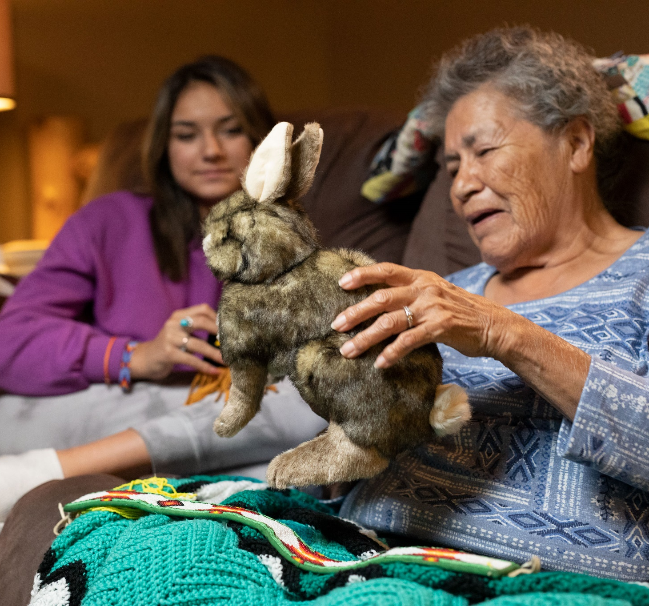
Supplemental Education
Materials
Notes:
Bebiskaneyaashiikwe Wendy Merrill Amikogaabawiikwe Adrienne Benjamin Anangookwe Darcy Big Bear

Slide 29
WEBSITE
Registration Links
Link to Group Packet
FAQs
Flyers
Link to Supplemental Education Materials
Production Photos
About the Project
In the Media

Slide 30
GROUP REGISTRATION PACKET
Contact Info on each page
Information about this project
How to register your students, organization, or other group members
FAQs
System Requirements
Links to Group Resources
Help and Support Info
Notes:
The Group registration Packet was set up as sort of a one stop shop for everything you might need to present, purchase, install and administer Rosetta Stone.
Information about this project includes data on the features and benefits of language learning if needed to present to a school board or for grant writing.
How to register your students, organization, or other group members – information on how to register as a group to save time and make it easier.
Group FAQs – info on security and other questions administration might have.
System Requirements – to lighten the burden for your technology team
Links to Group Resources – SEM, headset set up, learner agreements and certificates of accomplishment
Help and Support Info – each level is tested quite thoroughly and we don’t come across a lot of issues, but just in case – we want to everyone to get up and running as soon as possible if they have trouble.

Slide 31
Supplemental Education Materials
Teacher’s Guides by Level
Glossary
Scope and Sequence
Audio Companions
Song Videos

Slide 32
A small selection of some of the comments that have been received…
“We keep what we have by giving it away...”

Slide 33
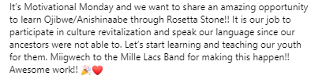
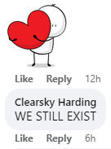
“I can’t tell you how long I’ve waited for this.”

Slide 34
+
Miigwech
Chato “Ombishkebines” Gonzales
Chato.Gonzalez@millelacsband.com
715-699-5535

