Slide 1
Zakab Biinjina
Aanjibimaadizing Housing

Slide 2
To assist our fellow Anishinaabe with education, training, work experiences, cultural participation, and support services to be prosperous and change their life. Mission Statement

Slide 3
Zakab is not Emergency Housing
Zakab does not provide immediate, emergency housing.
Clients must be successfully working on their plans for 3 months before receiving housing.

Slide 4
Three Tiers of Housing for Mille Lacs Band Members
Tier 3
Permanent Housing
Tier 2
Transitional Housing
Tier 1
Emergency Housing
Notes:
Tier 1 is emergency housing such as the Mino, women’s shelters, or other shelters.
Tier 2 is supportive housing. It helps people transition from one phase to another. This is what Zakab is.
Tier 3 consists of band housing, private rentals, home ownership, etc.

Slide 5
Temporary Housing Accommodations For People Who Are Homeless Or In Crisis
There may be a need due to circumstances caused by actions of the family that limits access to conventional housing options.
Examples include: people who are evicted, asked to leave the family house, couch surfing, in danger of being hurt if they stay in their home, and re-entry from prison or treatment.
Currently these types of circumstances are addressed through:
Emergency hotel stays provided by Emergency Services at HHS
Red Cross
Women’s shelters
Mino-bimaadiziwin
Tier 1: Emergency Housing
Notes:
Current MLBO housing does not provide case management support to people in crisis. People in need of emergency housing have an immediate need. Aanjibimaadizing cannot pay for hotel stays for clients - except in very limited circumstances. For example, if they have an apartment to move into next week, then the grant can pay for a temporary housing solution for a few days because a permanent housing solution has been set up.

Slide 6
Tier 2: Transitional Housing
This is supportive -but temporary- housing meant to bridge the gap from homelessness to permanent housing by offering structure, supervision, support, life skills, education, and training.
Zakab Biinjina will address and utilize family-centered planning to support the forward movement towards conventional housing options.
Zakab Biinjina is safe and sober housing. This is a critical component for clients in transition. Families must have three (3) months of successful case planning prior to moving into Zakab Biinjina.
Notes:
People in transitional housing require support to address life issues and maintain their housing successfully. One of the goals is to transition them into permanent housing.

Slide 7
Tier 3: Permanent Housing
The family has no barrier, or has demonstrated stability, in order to access housing options through the Band or through private avenues including renting or mortgage.
Notes:
This is when people are able to move into band housing, rentals or own their own home.

Slide 8
Zakab Support Services
Zakab Program Housing includes various support services for Aanjibimaadizing Clients include:
Weekly Case management
Goal planning
Mental health service referrals
Educational services
Employment services
Life skills training
Children’s services and activities
Support group referrals

Slide 9
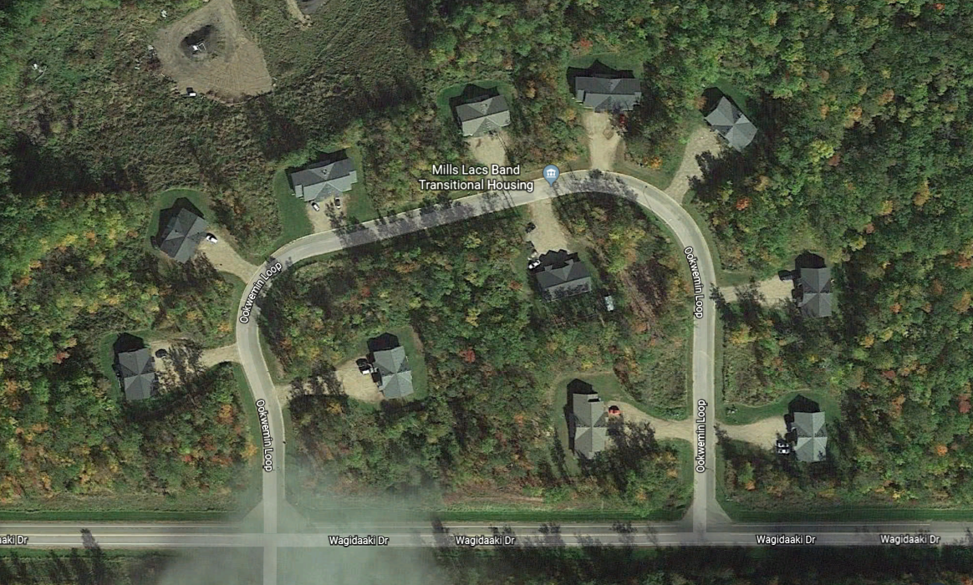
Housing Units Per District
District 1 | 20 Units
District 2a | 4 Units
District 2 | 2 Units
District 3 | 12 Units
Zakab Biinjina
Notes:
After successfully meeting their case plan goals at Zakab Biinjina housing, clients may be given a letter of recommendation from the Aanjibimaadizing program addressed to the Mille Lacs Band of Ojibwe Housing Department, or other housing organizations.

Slide 10
Band Members Are Experiencing Challenges In These Primary Areas
1. Long-term Homelessness 2. Unemployment / Underemployment 3. Treatment & Therapy 4. Negative Peer / Community Associations 5. Re-entry from prison or jail
Notes:
Aanjibimaadizing programs are here to walk with clients or assist clients as they move from old lifestyles to new lifestyles. This process needs to be client led.

Slide 11
Apply person-centered philosophy using an individual’s active participation to develop their own vision and goals, which then identify the services and supports needed.
Approach to Support
Mille Lacs Band Members
Notes:
The individual’s voice and choices become an integral part of the decision-making process leading towards self-sufficiency. Aanjibimaadizing uses the “Strengths, Needs, and Cultural Discovery” Assessment (SNCD) to ask clients open-ended questions that identify their needs and strengths. This information is used to develop their case plan.
Clients must remain actively working their case plan while living in Zakab.

Slide 12
Number of days clients are housed
Number of child protection cases with family reunification
Number who transitioned to permanent housing
Original housing barrier has been addressed
Financial health has improved
Number of natural supports has increased (support and assistance from family, school, work, and community)
Key Performance Indicators
Notes:
Client’s goals are identified and then worked on.
Clients are also encouraged to find people who will support and assist them with their new life choices. Often these relationships are developed in natural environments such as the family, school, work, and community.
Data will be tracked by Case Managers and Facilitators using case notes to identify outcomes and the successful completion of outcomes.

Slide 13
Successes of the Past Year (FY 23)
Aanji has assisted more
than 4982 families with
housing barriers
All families have increased their
financial health
All have increased their natural
supports and increased family
stability
16 Children were reunited with their parents
7 babies were born
238 referrals for outside services
50 families transitioned to permanent housing
32 of 38 units are occupied (2 are offices and the others are being prepped for move in)
12 families are completing the work to enter Zakab soon
Many have received furniture and/or home supplies that have been donated to the program
Total housing assistance program funds dispersed since FY21 $6,009,089
Helped approximately 100 elders in the community to pay utility costs last winter
Notes:
Programs build and grow as they demonstrate success.
Success is not measured solely by how many housing units are occupied, but also by how many families made real changes to improve their lives.
Some barriers can be addressed by us without Zakab, but it is always a useful option in the spectrum of options.
Please note we have not been operating the program for a full year. The policies were not passed until May 2021.
There are 38 units currently.
It should also be noted that Tribal police told one of the Facilitators that we were doing good work on the Loop because they did not know any of tenants, as they do not need to go there.

Slide 14
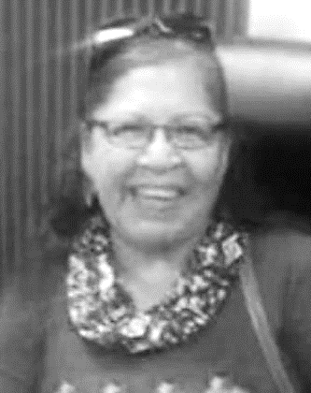
"The message I would want Band members to hear is that you can accomplish anything you set your mind to if you have the initiative and determination to make it happen.”
Joycelyn Shingobe - 2003

