Slide 1
Aanjibimaadizing
Mille Lacs Band of Ojibwe
Notes:
Aanjibimaadizing translates to “changing lives”.

Slide 2
Our Story
Aanjibimaadizing is operated as a service organization under the Mille Lacs Band's Department of Administration.
Aanjibimaadizing helps to empower participants with a purpose or an occupation that will contribute to the well-being of their community and family.
Notes:
Through this, we are able to offer services to a large percentage of our community and work closely with other organizations to help all ages overcome barriers to sustainability while embracing their culture through a variety of programs.
Our main function to help people obtain and maintain employment.

Slide 3
Mission Statement
To assist our fellow Anishinaabe with
education, training, work experiences,
cultural participation, and support services
to be prosperous and change their life.
Notes:
Our core belief is that ALL people should be treated with minwaadendamowin and zhawenjigewin, respect and kindness.

Slide 4
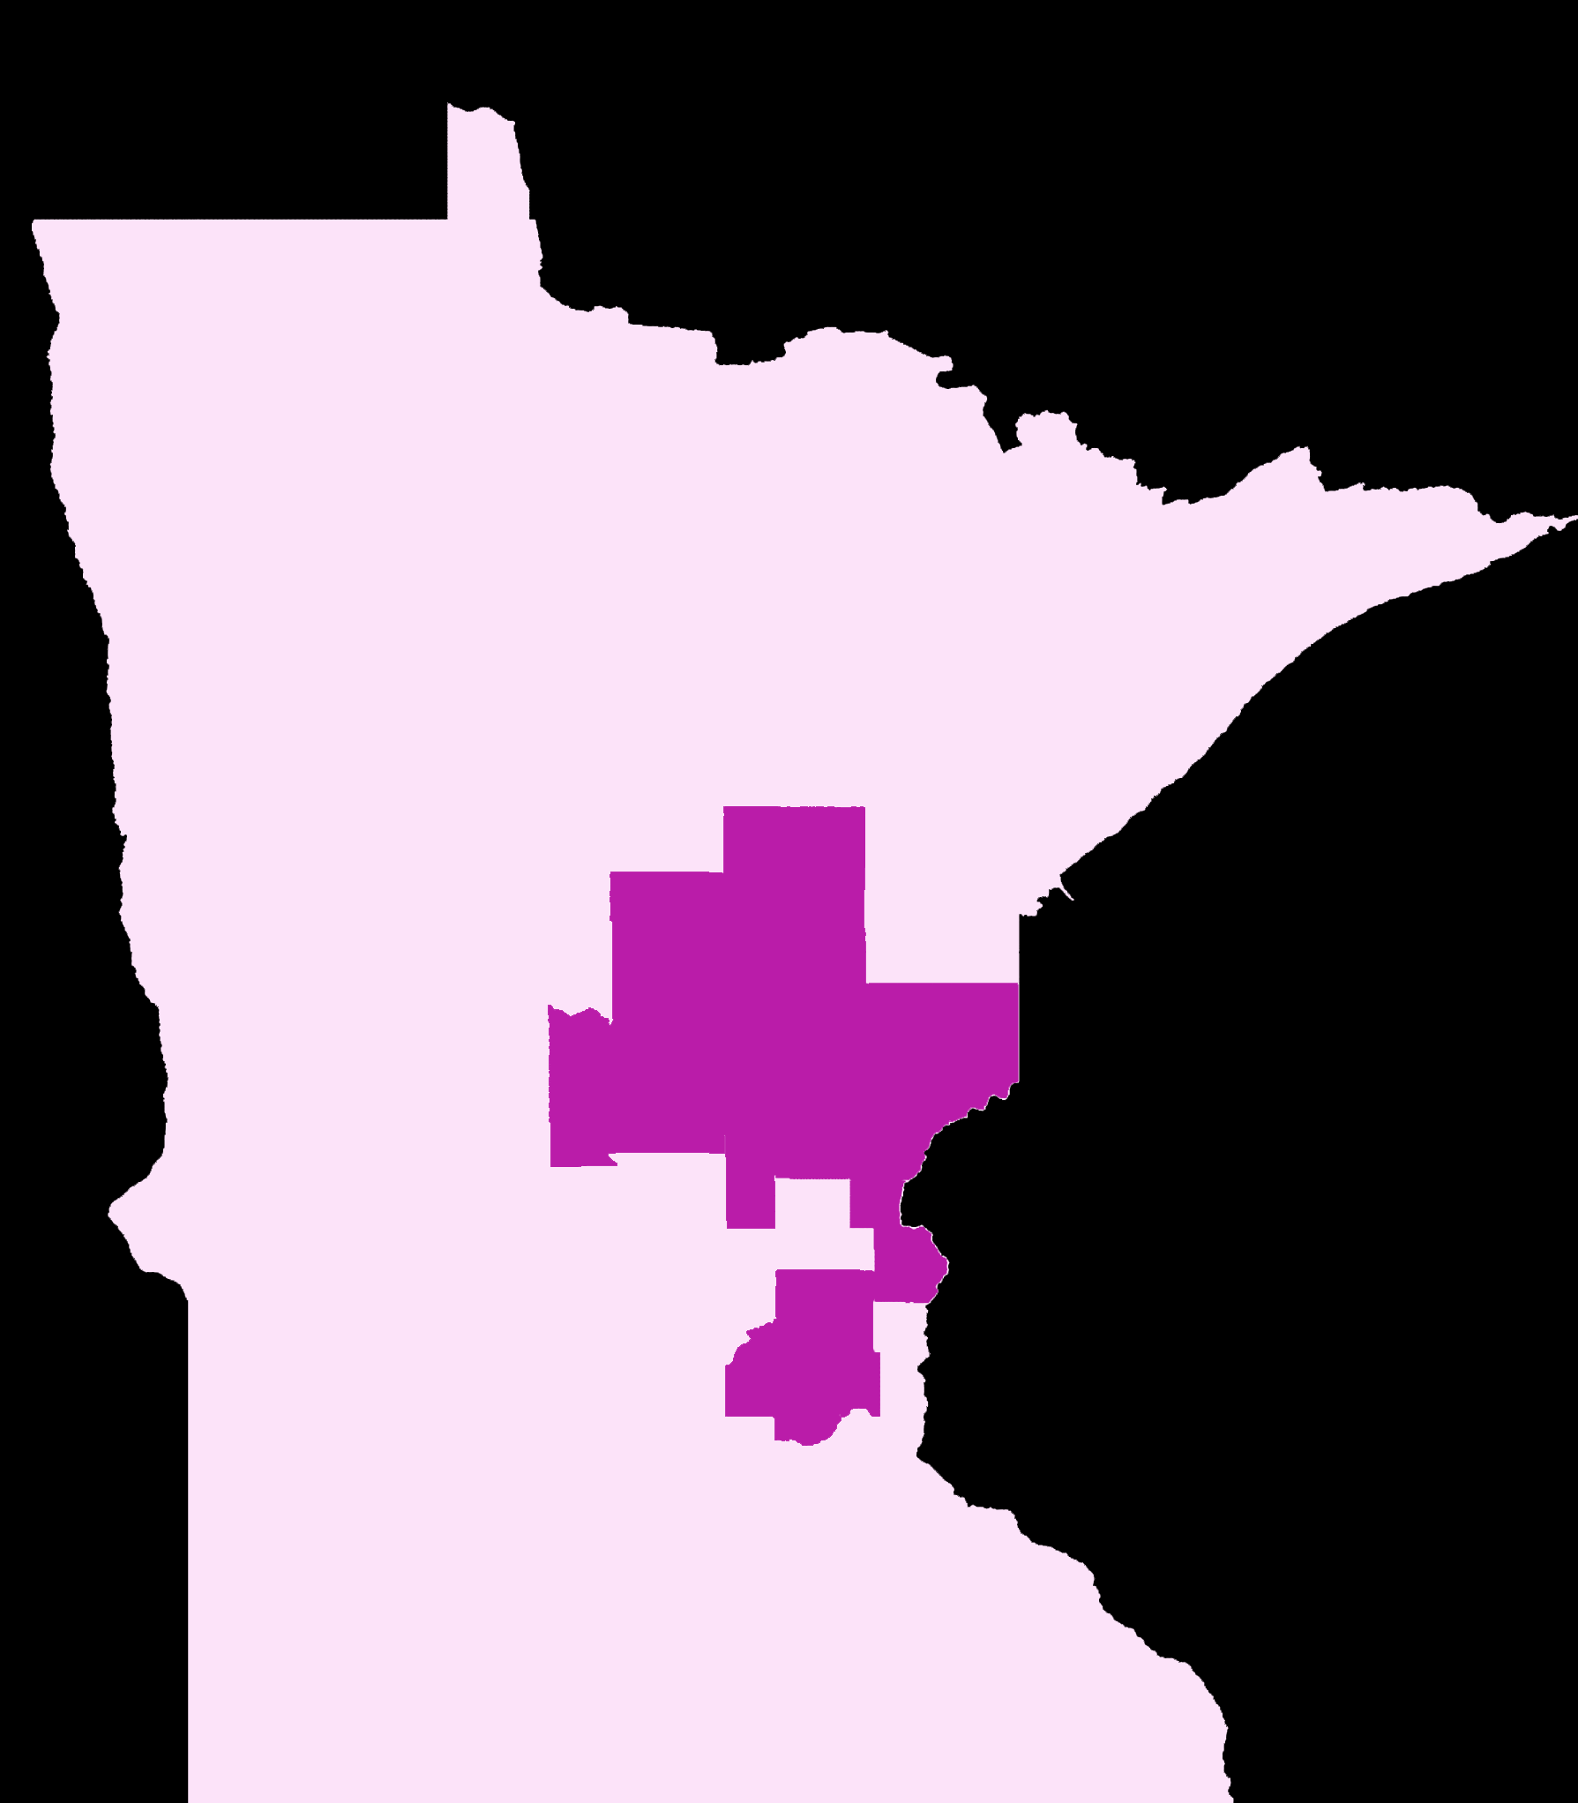
Locations
Aanjibimaadizing has offices in the Urban area, District I, District II, and District III.
The offices are open to walk in clients.
Clients can also call or email.
Our service area includes the counties of:
Aitkin
Benton
Chisago
Crow Wing
Kanabec
Mille Lacs
Morrison
Pine
Anoka
Hennepin
Ramsey

Slide 5
Public Law 102-477
Intended for employment, training, and services that may enhance a person’s ability to become self-reliant; Public Law 102-477 provides for sovereignty and builds capacity in Indian County by authorizing tribal governments to integrate eligible employment, training, and related services that support workforce development based on tribal goals and initiatives.
Notes:
Most of Aanjibimaadizing’s funding comes from PL 102-477.

Slide 6
Funding Sources
Department of
Health and Human Services
Temporary Assistance for Needy Families (TANF)
Child Care Development Fund (CCDF)
Native Employment Works (NEW)
Department of
Labor
Workforce Innovation and Opportunity Act (WIOA) Adult Services
Workforce Innovation and Opportunity Act (WIOA) Youth Services
Quality Jobs, Equity, Strategy, and Training (QUEST)
Department of
the Interior
Job Placement and Training (JPT)
Welfare Assistance
All funds combine and are used to fund all services in the MLBO 477 plan as written and submitted.
Notes:
The estimated annual allocation of the combined grant funds total is $5,147,597.

Slide 7
Funding Sources
Department of
Health and Human Services
Temporary Assistance for Needy Families (TANF)
$4,550,816
Child Care Development Fund (CCDF)
$191,580 FY16
Native Employment Works (NEW)
$61,723
Department of
Labor
Workforce Innovation and Opportunity Act (WIOA) Adult Services
$52,249
Workforce Innovation and Opportunity Act (WIOA) Youth Services
$23,295
Quality Jobs, Equity, Strategy, and Training (QUEST)
$493,552.44 FY23
$506,447.56 FY24
Department of
the Interior
Job Placement and Training (JPT)
$64,031
Welfare Assistance
$155,003
All funds combine and are used to fund all services in the MLBO 477 plan as written and submitted.
Notes:
The estimated annual allocation of the combined grant funds total is $5,147,597.

Slide 8
Services
Culture  Youth  Adult  Elder

Slide 9
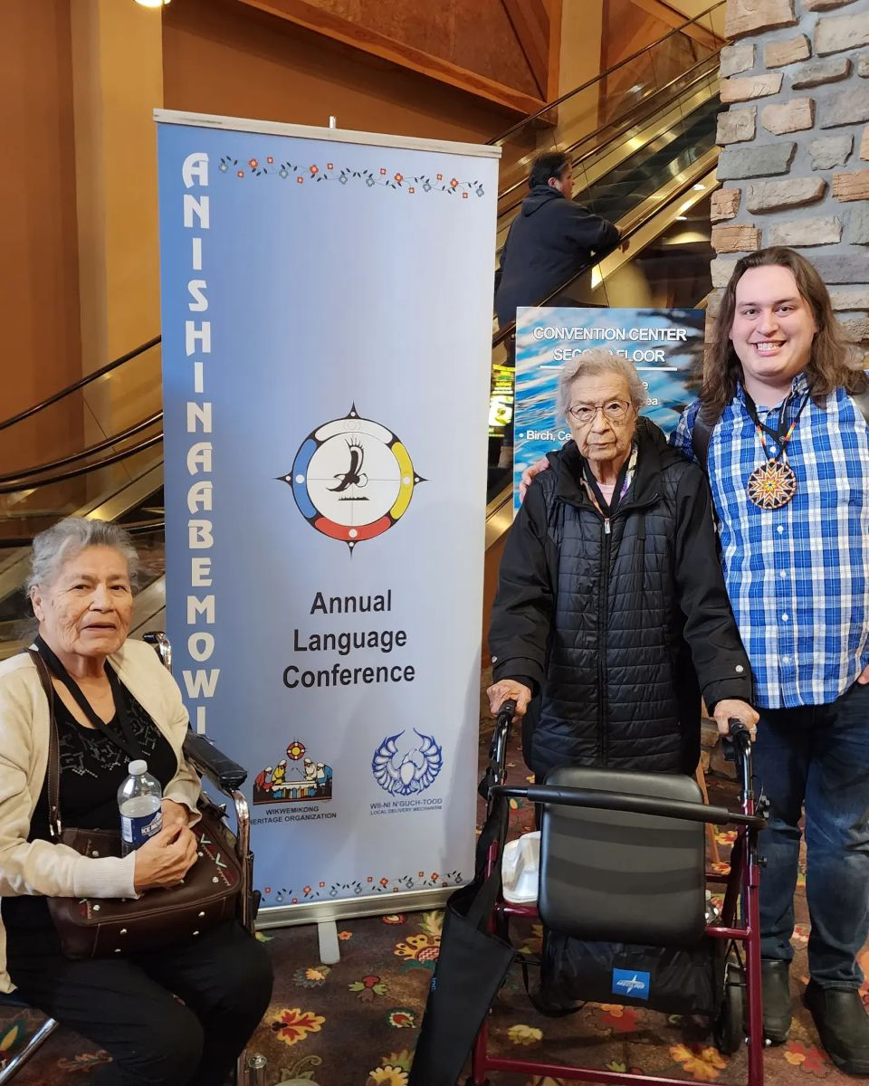
Ojibwe Culture
It is the purpose of Aanjibimaadizing to prepare the members of the MLBO community to contribute to the Mille Lacs Band.
While a primary part of this contribution is in the form of employment that helps enrolled members thrive financially, it is of equal importance that MLBO membership reflects the unique history and culture of its people.
As such, the Program also recognizes the vital role of education in traditional cultural and linguistic practice which allows those who receive services to contribute across the whole spectrum of membership in the Mille Lacs Band community.
Notes:
We do this by supporting a cultural apprentice program and having multiple cultural opportunities for youth and including cultural activities for TANF participation.

Slide 10
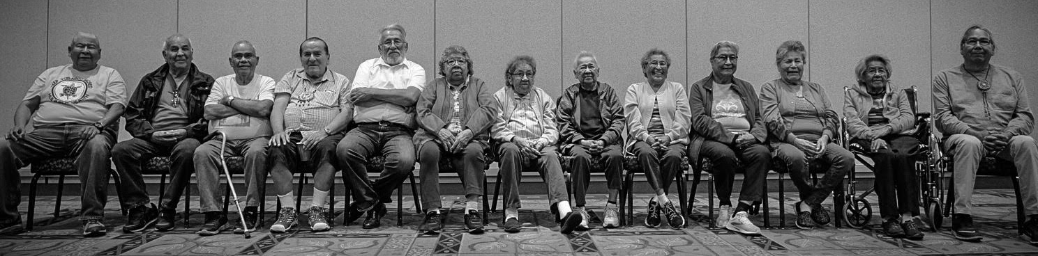
Language
We have secured over 150 stories from our elders in our Ojibwe language.
Notes:
Some of these, as well as other resources can be found on the culture section of aanji.org.

Slide 11
Ojibwe Language Books
Aanjibimaadizing has completed five Ojibwe-language books of collected stories from elders, comprising two illustrated books for children and one for high school learners and two for general readers of Ojibwe.
Notes:
These can be purchased at the museum or through the Minnesota Historical Society.

Slide 12
Mille Lacs Band Ojibwe Rosetta Stone
The first level of the launched in March 2022. The second level was released in March of 2023.
Research has shown that cultivating connections with one’s Indigenous language and culture contributes to improved physical and mental wellbeing, and therefore success in school, family, and workplace.
Notes:
The curriculum is designed to appeal to the broadest possible range of learner interests and abilities, with special emphasis on conversational speech appropriate to both the home and workplace.

Slide 13
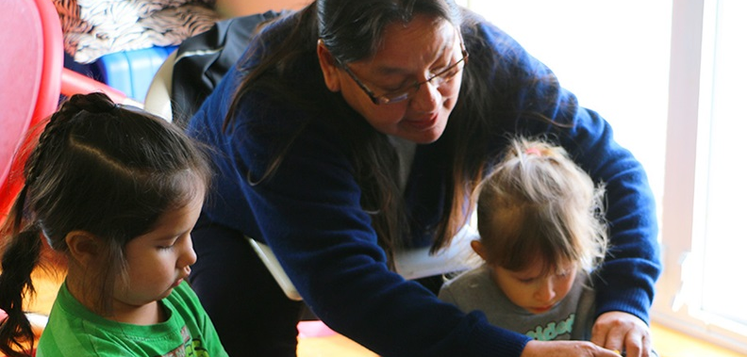
Childcare Assistance
Childcare assistance is available for families who are employed or enrolled in educational programs.
There are 3 Types of Child Care that qualify for assistance:
Center based
Licensed Family Child Care
Legal Non-Licensed (must be provided by a relative)
Apply by contacting Rose Wind at
rose.wind@millelacsband.com or 320-362-1383

Slide 14
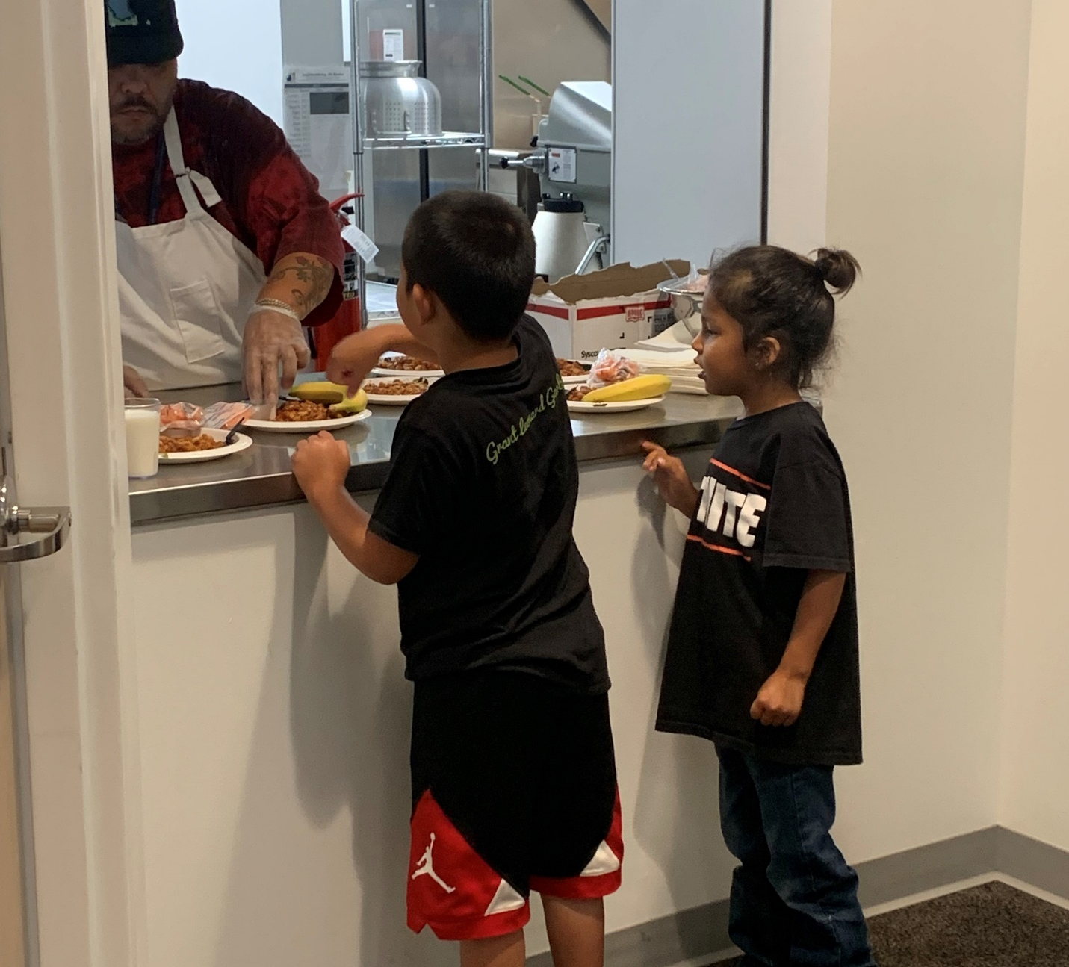
Ge-niigaanizijig for Elementary Youth
Ge-Niigaanizijig works to develop skills in the 4 pillars of youth programming Ojibwe Culture, Community, Career, and Education through healthy learning activities with kids ages Kindergarten through Grade 6 in DI, DII, DIIA, AND DIII.
Notes:
Aanjibimaadizing combined with the Niigaan youth programming January 1, 2020.

Slide 15
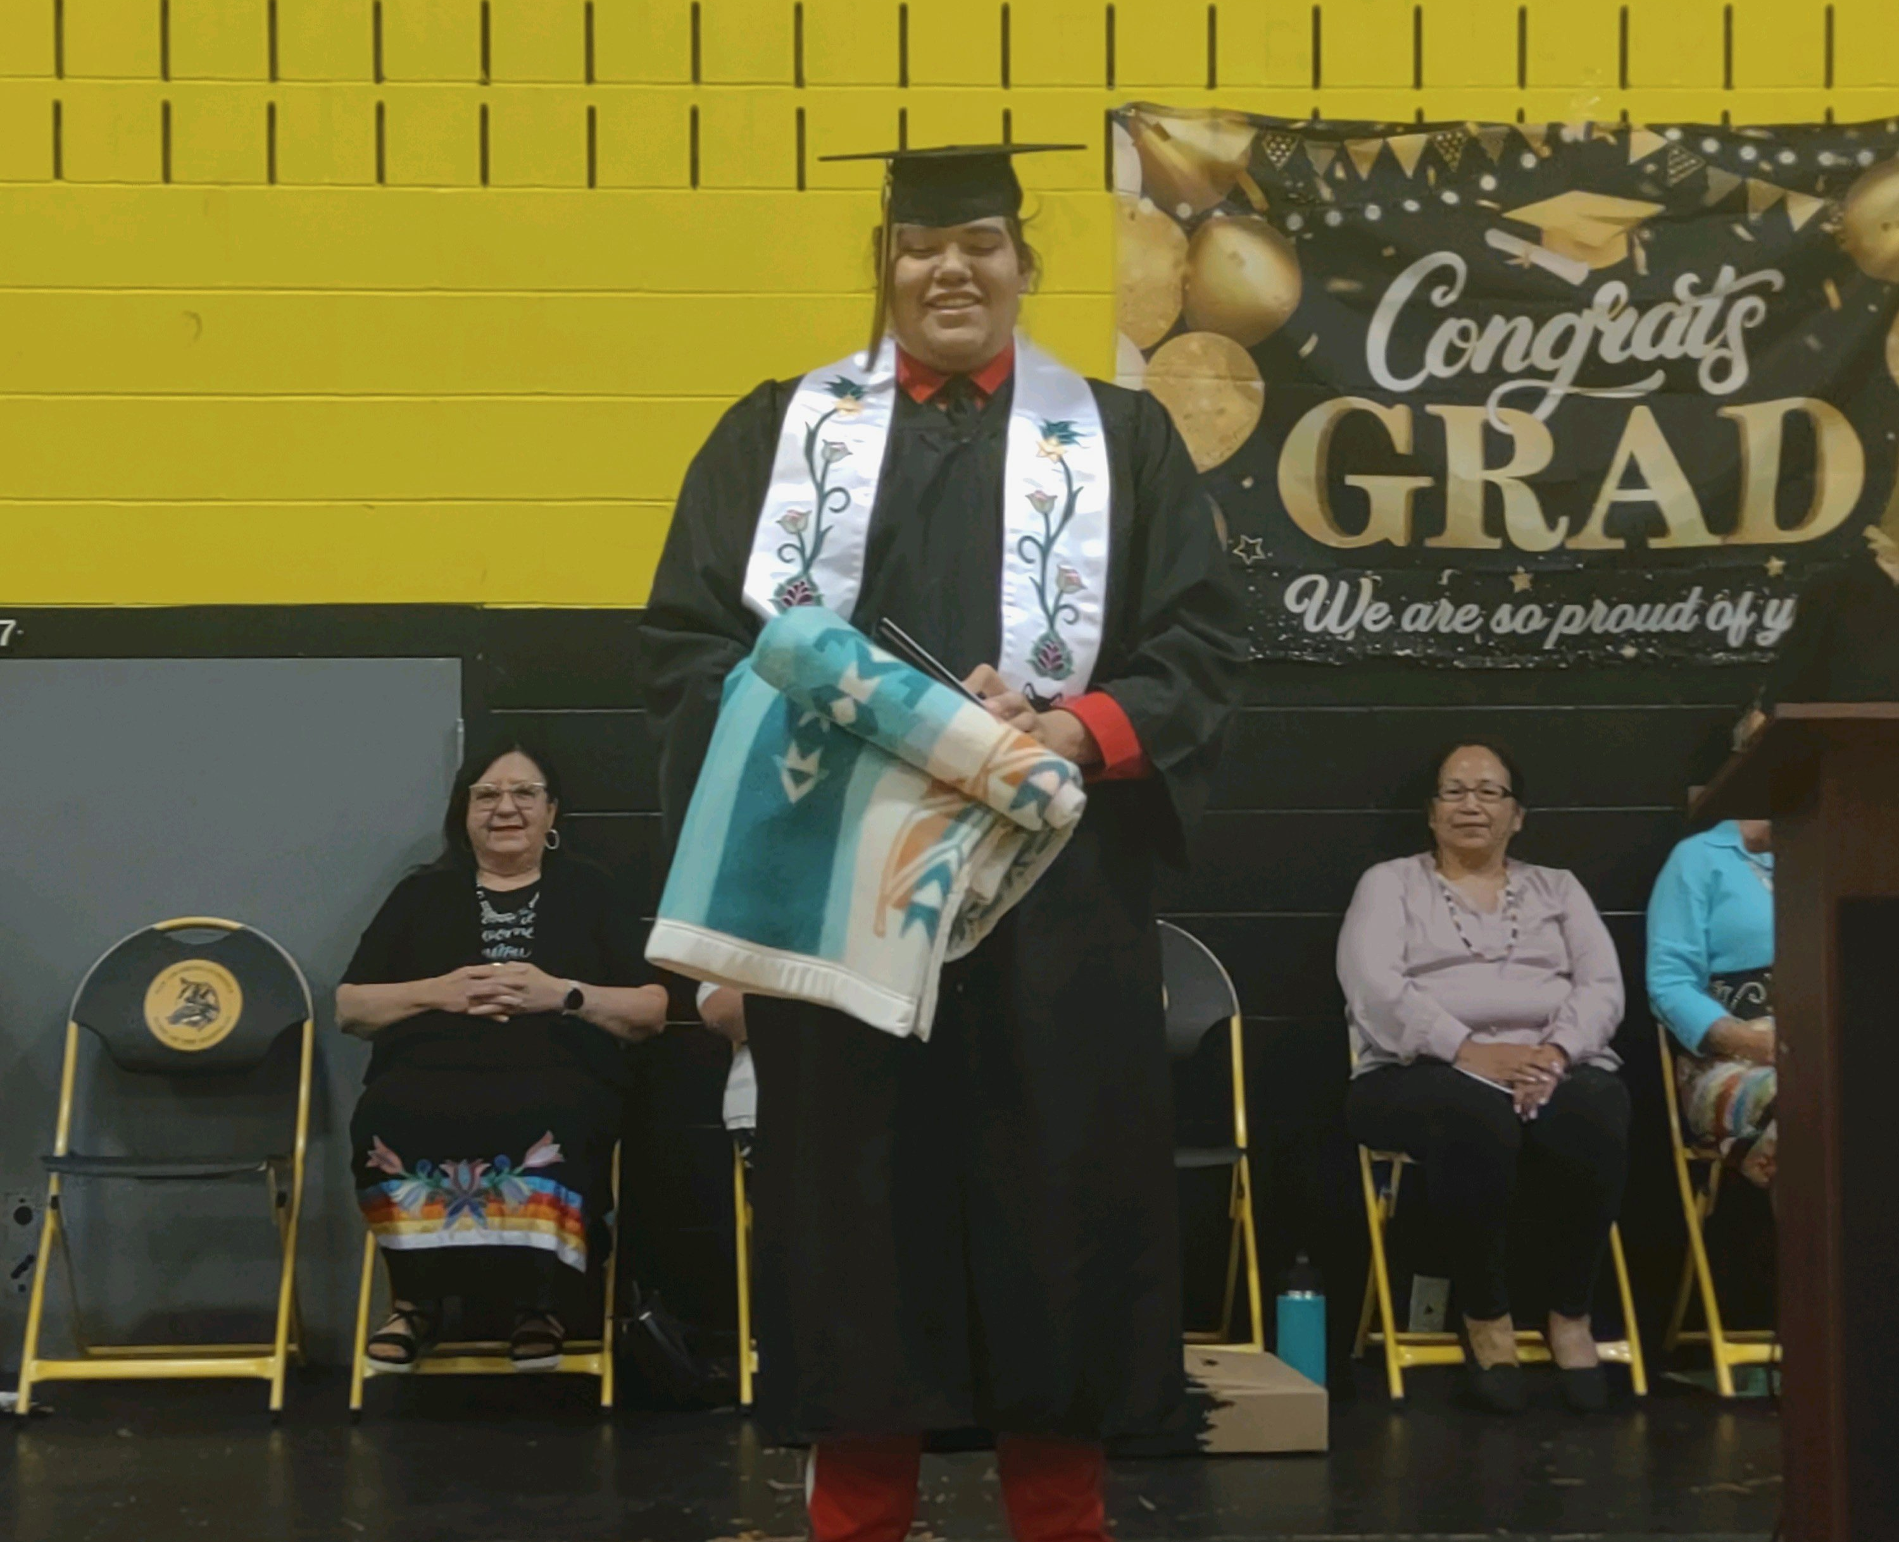
Ge-niigaanizijig for Teens
Teen Mentors provide Healthy Circles and Expanding the Circle programming in all Districts including Urban.
These activities are offered to all eligible reservation service area youth ages twelve (12) through twenty (20).
Notes:
Regularly scheduled meetings and activities inspire and motivate our youth to embrace a traditions-based lifestyle free of chemicals or risky behavior.
Cash incentives and awards are made to teens who meet program participation and achievement goals.
New pictures?

Slide 16
Teen Career & Work Exploration
Eligible youth, ages sixteen (16) through twenty (20) may participate in the Youth Career and Work Exploration Program.
To be eligible you must be in school, making satisfactory attendance and grades. The type of work and the number of hours worked per week depend on the needs of the worksite supervisor.
We also support teen internships through Mille Lacs Corporate Ventures and our Summer Internship Program.
Notes:
Youth are given an incentive for actual hours worked.
We had 22 interns for the Summer Internship Program in 2023.

Slide 17
Youth & Teen Support Services
Eligible youth ages kindergarten through twenty (20) who are enrolled in school may receive supportive services for such things as:
New employment clothing and/or supplies when required by the employer
Driver’s Education costs
Athletic or academic program fees and supplies may be used if the school does not have JOM funding
Special tutor costs (such as individual music lessons)
Leadership, education or cultural camp registration costs

Slide 18
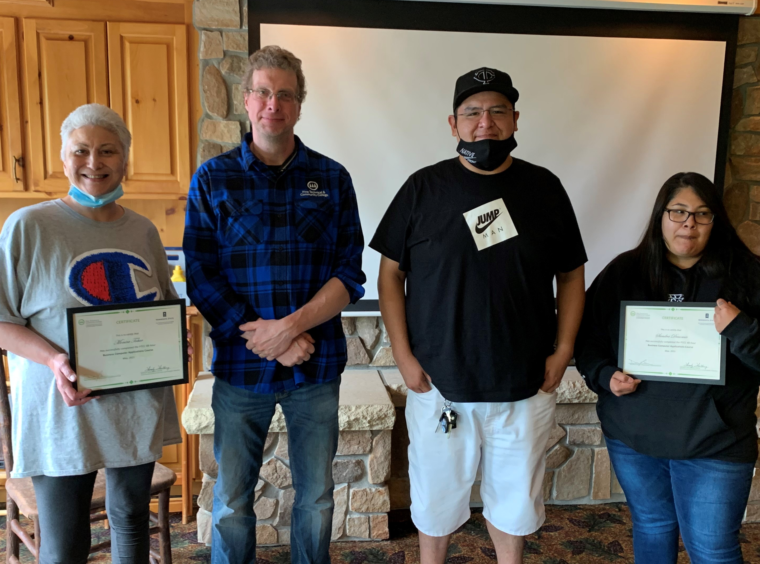
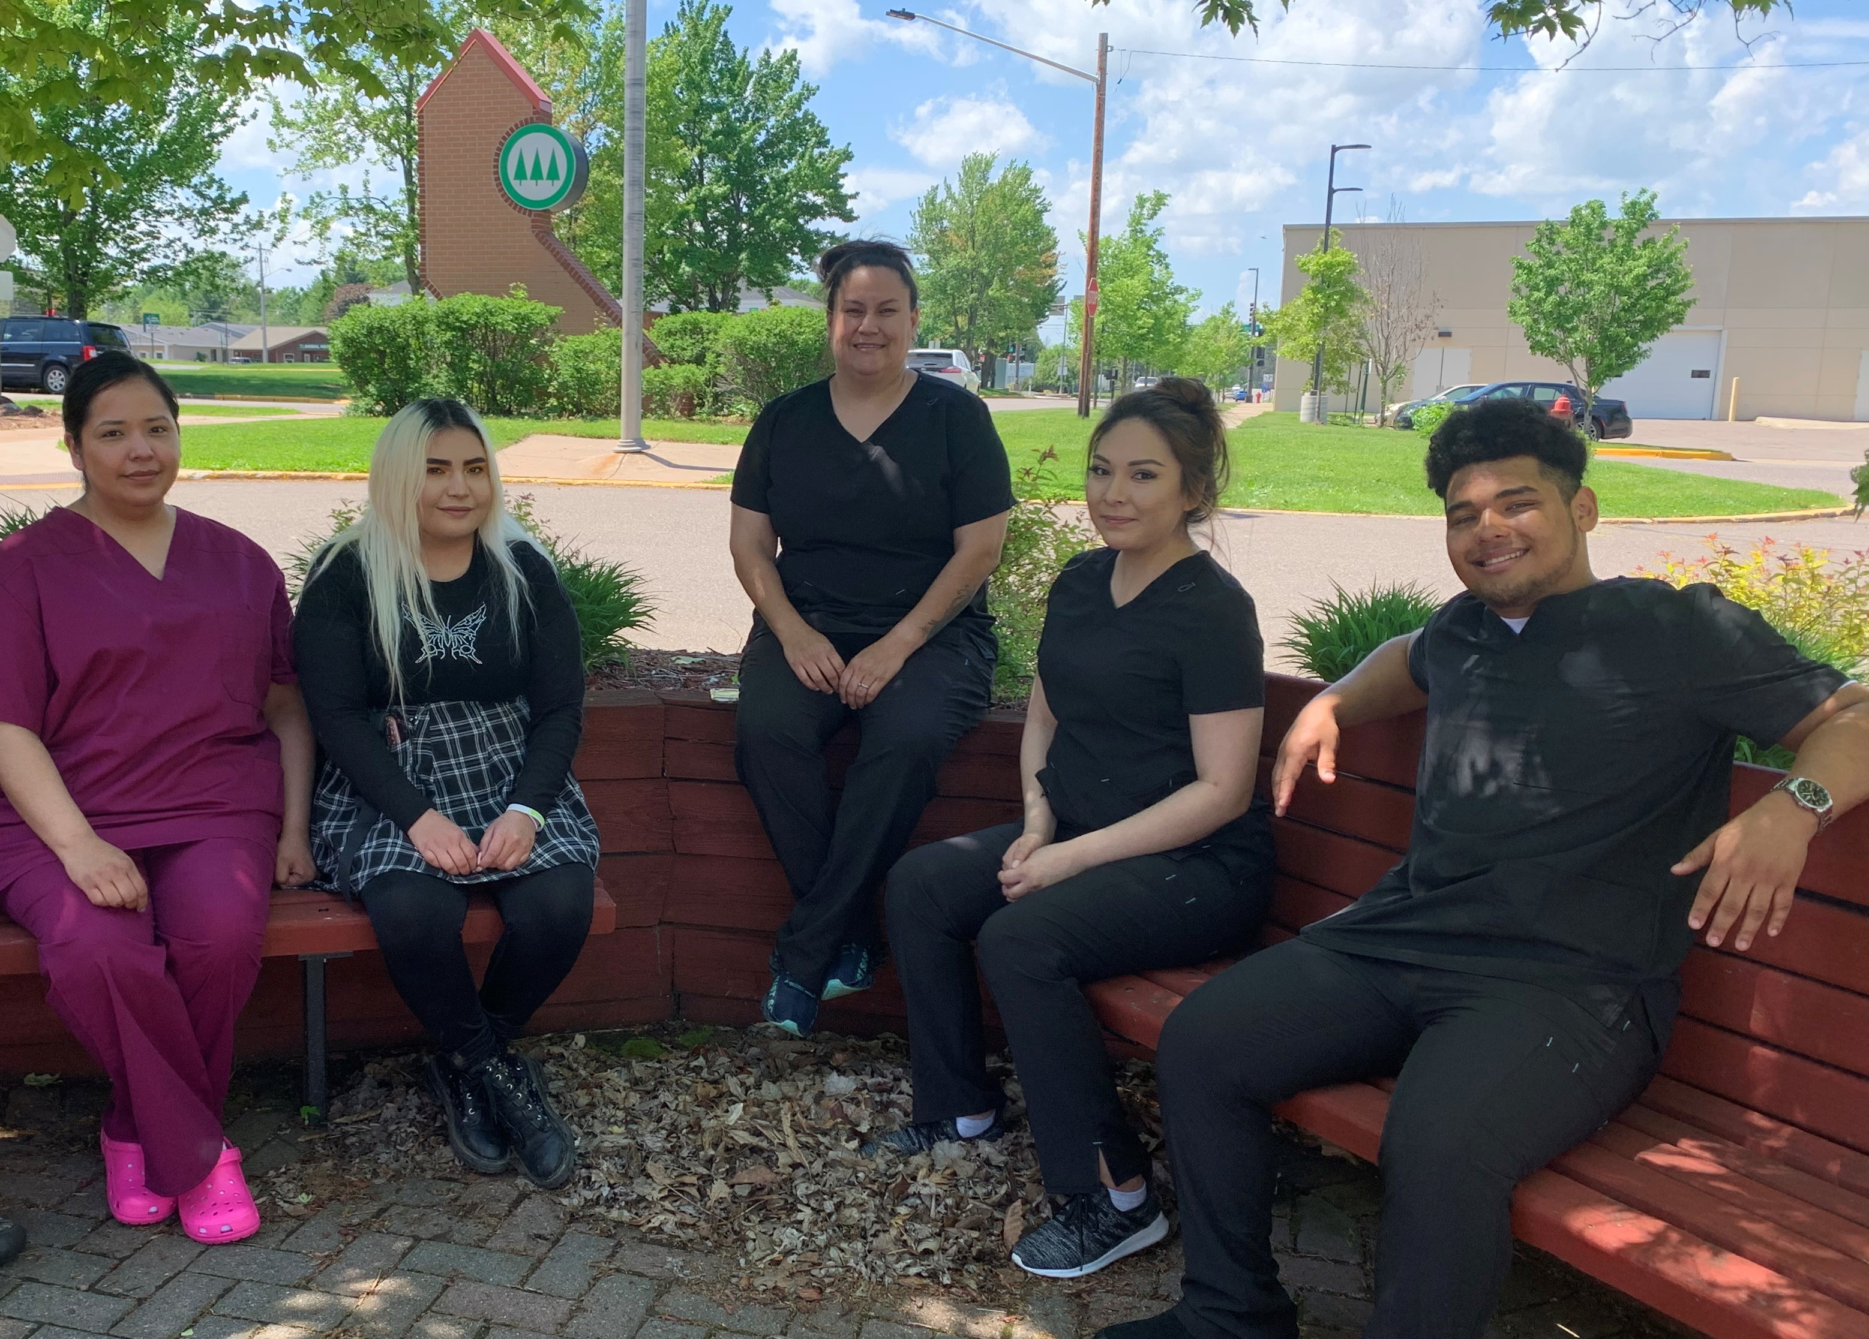
Career Training & Development
Aanjibimaadizing regularly provides basic work and family related trainings.
These include such topics as:
GED Preparation
Drivers License Exams
Budgeting
Parenting
Food Handling
Communication
Job Skills
Work Safety
Notes:
New Pictures ?

Slide 19
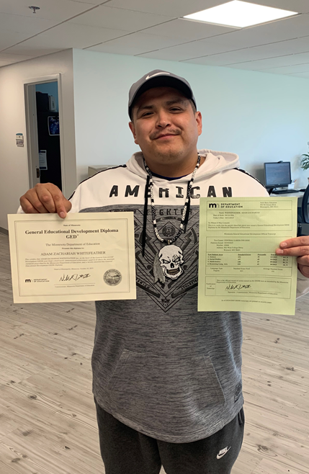
Adult Basic Education
In 2023, the Mille Lacs Band became an Adult Basic Education Consortium.
Adult Basic Education (ABE) is a state-wide system that serves adults who are working towards a high school credential, learning English, improving basic skills such as literacy and math, and/or preparing for post-secondary education or employment.
Notes:
The main goals for the MLBO ABE Consortium include:
The ability to be able to offer a consistent, viable ABE process.
Increase opportunities for our clients and make it easier for clients to complete the General Educational Development Test and obtain their diploma.
Gain “lost” funding that we are not able to access because we are not a consortium.

Slide 20
Some of the trainings that have been offered include:
ACEs
Acing your Interview
Administrative Assistant
Adult Basic Education
Advanced MS Excel
Advanced MS Word
Auto Technician
Basic Computer Skills
Behind the Wheel
Building Native Communities
Business Applications
Career Readiness
Case Management
CDL
CNA
Community First Service & Support Training
Comp. Tia A+
COVID-19 Safety
Creating Resilient Youth
Developmentally Appropriate Behavior Guidance
Digital Literacy
Digital Marketing
Domestic Violence Support
Driver’s Education
Dual Language Learners
Emergency Medical Technician
Empowerment Workshop
Endazhi-maawanji'idiing
Fatherhood & Motherhood is Sacred
Financial Literacy
First Aid/CPR
Growing Resilient Communities
Hands-on Activities to do in the Spring
Heavy Highway Carpenter
Insights
Intermediate MS Excel
Intermediate MS Word
Interview with Confidence
Interviewing
Intro to Child Development
Intro to Job Search
Intro to MS Excel
Intro to MS Word
KnowBe4
Leadership
Linking Generations
Mending Broken Hearts
Mind Body Medicine
Motivational Interviewing
Narcan Administration
Networking
Ojibwe Rosetta Stone
Parenting Piece by Piece
Pathways to Native Business Plan Development & Sustainability
Personal Care Assistance
Personal Fitness Trainer
QuickBooks
Reclaiming Native Psychological Brilliance
Recovery Coach
Remembering Resilience
Resilient Caregivers
Resume Class
SafeSide Prevention
Serv Safe
Small Engine Repair
Trauma Informed Care
WEX Orientation
Winning Resumes

Slide 21
Small Business Development
A limited amount of funding is available for small business development.
Applicants for this program must be current Aanjibimaadizing clients and complete a small business plan prior to receiving funds.
Plans must be specific, thorough and include what the funding will be used for. The maximum amount to be awarded is $1000. The amount awarded is dependent on the business plan created.
All applicants must demonstrate the capital or funds they are investing in the small business as well and must have a 25% match for the funds that they apply for.
Endazhi-maawanji’idiing
Endazhi is a group that was started to help fulfill business ownership goals and achieve greater success.
Learn about entrepreneurship and the responsibilities of owning a business
Outline, organize, and achieve your goals
Determine how your business will operate
Compile a business plan to showcase how your business will operate, and grow
Analyze results and make strategic decisions
Notes:
See the Small Business Development Information for additional details.
People receiving this must report how many people they have employed in the previous year.

Slide 22
Adult Work Experience
Reliability
Team Building
The Work Experience (WEX) Program is a 720-hour on-the-job work experience training program structured to promote self-sufficiency through the development of appropriate work habits and job skills.
Safety
Achievement
Notes:
The program is designed to move the participant to unsubsidized, career-oriented work by building their talents and abilities. Its incentives are directly related to mastery of four critical work behaviors: Reliability; Safety; Team Building; and Achievement.

Slide 23
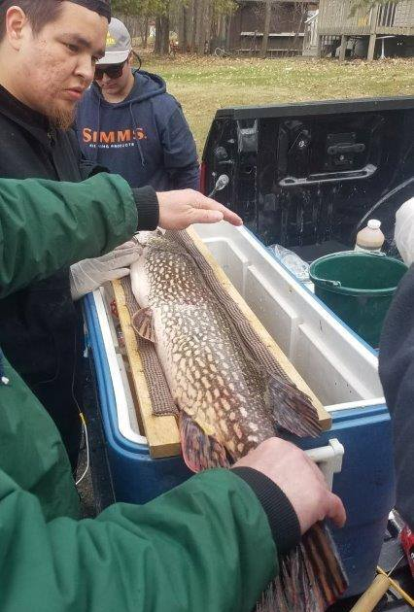
Adult Partial Subsidy Work Program
Participants who demonstrate that they are work ready and who are hired into career oriented, long-term, stable employment may arrange to have the first 720 hours of their new employment subsidized.
These subsidies are paid to the employer, not the employee. A special contract with the employer is required that specifies the terms of agreement for the employer and Aanjibimaadizing.

Slide 24
Aanji Garage
The Aanji Garage was developed as a training program for clients to learn mechanical skills that lead to employment while providing automobile services for the Mille Lacs Band of Ojibwe Departments.
The goals of the program are to:
• Introduce clients to Auto Repair as a potential career while helping them gain talent, confidence, and provide skills that can build a lifetime of self-sufficiency.
• Protect the Mille Lacs Band investment and provide a reliable and trustworthy place to service their vehicles.
Oil Changes & Fluid Checks
Tires, Brakes & Suspension
Belt & Hose Replacement
Diagnostics
Tune Ups
Light Vehicle Repairs
Auto Detailing
Small Engine Repairs
Notes:
We can only service Mille Lacs Band Tribal Government vehicles. The Aanjibimaadizing Garage is not able to provide service for private vehicles or the casino. Each department is responsible for the expense of all labor, parts and/or supplies which are needed to complete the project. All services performed at the Aanjibimaadizing Garage are by a trained mechanic with assistance from WEX Trainees as part of a learning project.
WHY SHOULD YOUR DEPARTMENT USE THE AANJI GARAGE?
1.Support projects the Mille Lacs Band has invested in
2.Protect your department’s investment
3.Receive consistent, quality service and competitive prices
4.Able to trust diagnosis - and know that the Band isn’t being taken advantage of
5.Money spent stays within the community
6.Ensure safety of staff and those you serve
7.Community members gain skills and knowledge that is often shared and passed onto others

Slide 25
Adult Support Services
Adult Support Service payments are single payments to vendors to assist participants in overcoming specific, immediate and essential family stabilization or employment related barriers.
Those eligible may receive supportive services for such things as:
New employment clothing and/or supplies when required by the employer
Driver’s Education costs
Leadership, education or cultural training registration
Notes:
The expenses must:
Be specific.
The participant must be the owner of the obligation.
Be directly related to education or employment.
Verified as not otherwise provided free of charge or available from other resources.
Be the only way available to meet the need.
Be documented with evidence of the need verified.
We do not pay for out of state training.

Slide 26
Temporary Assistance to Needy Families
Tribal TANF Cash Assistance makes monthly cash payments to families with minor children based on family size and composition.
These benefits require participating adults to agree and to follow a case plan designed to move them away from assistance and to self-reliance.
Cash Assistance has a 60-month lifetime limit.

Slide 27
Supplemental Nutrition Assistance Program
The Supplemental Nutrition Assistance Program (SNAP) is a State of Minnesota program that provides cash assistance specifically for food purchases.
SNAP benefits can now be applied for and administered through Aanjibimaadizing in the northern counties.
Notes:
We also had a pilot program for SNAP E&T this year.

Slide 28
Facilitated Services
Clients who need extra support will be referred to a facilitator who assist in addressing life barriers.
These barriers to employment may include a need for substance abuse treatment or support, mental health treatment, felonies, or a lack of significant work history.
Notes:
Professional counseling and/or assessments may be a prerequisite, or a concurrent requirement with employment and educational services.

Slide 29
Homeless Housing Support
If they qualify, clients may access support including long term homeless prevention and state opioid response funds. Most of this funding is one-time funding.
Notes:
This is a very limited amount of funding.

Slide 30
HAF Homeowners Assistance Fund
The Homeowners Assistance Fund is federal funding that can provide full or partial payment assistance to eligible homeowners unable to make full delinquent mortgage payments and provide funds to resolve delinquent payments for utility services, excluding phone and internet, due to a continuing financial hardship associated with the Coronavirus pandemic.

Slide 31
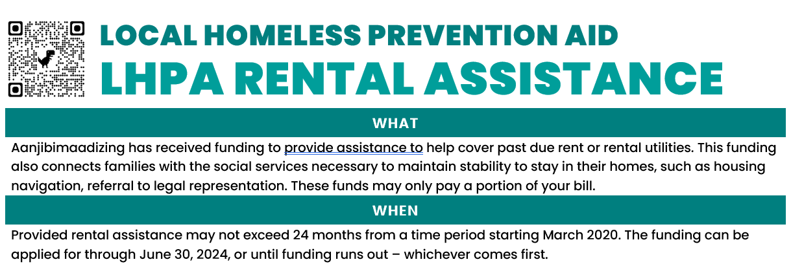
LHPA LOCAL HOMELESS PREVENTION AID
Aanjibimaadizing has received funding to provide assistance to help cover past due rent or rental utilities.
This funding also connects families with the social services necessary to maintain stability to stay in their homes, such as housing navigation, referral to legal representation.
These funds may only pay a portion of your bill.

Slide 32
Zakab Biinjina
Zakab is supportive - but temporary - housing meant to bridge the gap from homelessness to permanent housing by offering structure, supervision, support, life skills, education, and training.
Some of the objectives for this program include:
To provide a safe and healthy environment to live
To promote the development of families and self-sufficiency of the members of the Mille Lacs Band of Ojibwe
Clients must participate in active Case Management for 90 days before entering Zakab housing.
Notes:
Primary Objectives
To promote the development of families and improve access to supportive services, thereby benefiting the members of the Mille Lacs Band of Ojibwe.
To promote self-sufficiency of the members of the Mille Lacs Band of Ojibwe.
To promote an environment of zero tolerance for the use or possession of controlled substances without a prescription.
To promote an environment of zero tolerance for the use or possession of alcohol and/or drugs, unless being used as prescribed.
To develop, operate and maintain a place to live short term while in the Zakab program in a safe and healthy environment on the Mille Lacs Band reservation.

Slide 33
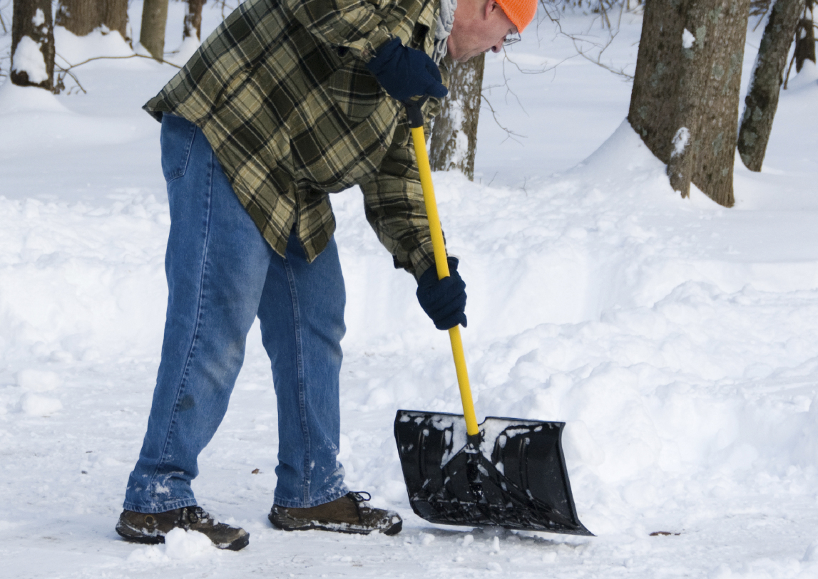
Elder Services
In addition to many of the other programs mentioned, elders may also be eligible for:
COMMUNITY SERVICES TO ELDERS
Aanjibimaadizing has Community Service Crews in all reservation districts that provide lawn mowing, yard maintenance, limited outdoor home maintenance and walkway snow removal for Elders living in one of the Reservation Districts if they apply.
These crews are staffed with Aanjibimaadizing staff and WEX Program participants.

Slide 34
How to Apply
Eligibility  Application  Contact Information

Slide 35
Eligibility
An eligible client must be an:
Enrolled member of the Mille Lacs Band of Ojibwe; or first generation descendent of the Mille Lacs Band of Ojibwe; or an enrolled member of a federally recognized tribe; or
For TANF, if residing within the Urban Service Area, an enrolled member of the Minnesota Chippewa Tribe.
Eligible households must also reside in one of our federally approved service areas within one of the Minnesota counties of Aitkin, Benton, Chisago, Crow Wing, Kanabec, Mille Lacs, Morrison, Pine, Hennepin, Anoka, or Ramsey county.
There may be additional eligibility standards for various services.
Notes:
Financial eligibility is based on the household income with specific types of income excluded.
Veterans and veteran families, including survivor families, are given preference within any of these eligibility groups.

Slide 36
Information Needed
Signed application
2 months of income statements
Proof of residency
Selective service registration (males only)
A signed and dated employability development plan (EDP)
Additional information may be needed for various services.

Slide 37
Offices
DI
320-532-7407
43500 Migizi Drive
Onamia, MN 56359
DII
218-768-5330
22001 MN-210
McGregor, MN 55760
DIII
320-384-6240
45749 Grace Lake Road
Sandstone, MN 55072
Evergreen Court Unit 2481A
Hinckley, MN 55037
URBAN
612-872-1424
1404 E Franklin Avenue
Minneapolis, MN 55404
Notes:
Our offices are open to walk in clients.
Clients can also call or email.
Aanjibimaadizing also has an informational Facebook page.
Other MLBO departments make referrals to the programs on a weekly basis.

Slide 38
Case Manager Contact Info
District | Name | Office | Cell
1 | Rosa Sam | 320-532-7995 | 320-364-3187
1 | Kaari Weyaus | 320-532-7544 | 218-316-2437
1 | Camille Smith | 320-532-7407 | 320-982-0836
1 | Winona Crazy Thunder | 320-532-7559 | 320-364-3049
2 | Kathy Nelson | 218-768-5336 | 320-630-2671
2 | Morningstar Goodsky | 218-768-5337 | 320-630-0482
3 | Renee Allen | 320-384-6240 | 320-591-0559
3 | Michelle Pomerleau | 320-384-6240 | 320-630-3491
U | Winona Spaulding | 612-746-4824 | 612-360-7219
U | Autumn Ballinger | 612-872-4807 | 320-674-0655

Slide 39
Leadership Team Contact Info
Name | Position | Cell
Tammy Wickstrom | Executive Director | 320-364-9511
Kristian Theisz | Director of Community Services | 320-630-2687
Candace Benjamin | Director of Case Management | 320-362-0014
Carlos Merrill | Ge-Niigaanizijig Director | 320-674-4347
Wahbon Spears | Urban Site Director | 612-360-5486
Katye Hill | Program Manager | 320-761-0420
Dan Pagnac | Operations & Compliance Manager | 320-362-0904
Karen Pagnac | Training Manager | 320-362-4139
Tammy Moreland | Facilitator Coordinator/Coach | 320-292-1942

Slide 40
Recent Accomplishments…
Aanjibimaadizing was awarded the Division Chief’s Award in 2022
A community elder commented that Aanjibimaadizing was the best thing to happen to the reservation
After remodeling and hiring two staff, the Aanji Garage opened as a training and vehicle service center for Mille Lacs Band Departments
Construction began on the former clinic to renovate it into a training center
Online applications were developed for all program services (Aanji adult and youth programming, Rosetta Stone, CHAP, CERA, CERA-HUD, HAF and PEAF)
Rosetta Stone launched with 3,438 current licenses in use by members of 128 tribal nations
110 hours of audio (oral histories) have been collected
Nine cultural articles have been published in the Innajimowin
11 elder recordings have been archived
Suicide Prevention training and resources were developed and shared with MLB communities, employees, and four schools
Provided opportunities for youth and Band members to attend Timberwolves games
Transported multiple clients to treatment
Held 2nd Annual Winter Clothing Drive
Instructors helped 725 clients with an average of 18 clients assists per day
942 clients participated in 126 different training courses offered
142 clients were assisted in earning certifications through Pine Technical and Community College
443 clients were assisted with reinstatement fees and obtaining their MN driver’s license
Expanded small business development by providing funding to more than 20 clients in FY22
Currently there are 437 active Adult Employment, Education and Training clients and 16 TANF clients
In total, there have been 837 adult clients this past year
$251,780.64 were paid in support services
127 WEX participants provided 45,276 hours of labor to the community and local businesses as they learned job skills
Aanjibimaadizing became merit certified and is now able to administer SNAP
Facilitated services assisted with reuniting 17 families
49 families secured housing
20 families moved into permanent housing
Aanjibimaadizing distributed $4,313,067 dollars in special COVID-19 related funds since the start of the pandemic
Distributed Toys for Tots
Childcare assistance was expanded with a 36% increase in families served
Supported Mille Lacs Early Education
Supported construction at the D2 Head Start Child Care Remodel
New playground in Lake Lena is being built for Ge-Niigaanizijig and the community to use
Ge-Niigaanizijig expanded to Urban area and currently has 384 youth in the program
$487,552 in youth support services and activity support were distributed
77 people participated in the MMIW run
943 youth participated in Ge-Niigaanizijig sports and fitness programs
284 youth participated in clubs, camps and clinics
A youth led fashion show was held
Offered a holiday food and gift card giveaway for youth families
14 dog houses were built by youth and distributed to community members
Summer Internship program was successfully started
Nine youth are learning how to make meals in Cooking Club
40 youth were on the honor roll
16 youth graduated and eight started college
24 youth completed driver’s education and 17 received their permit
11 youth participated in Career Explorations, a job training program
There were 27 MLCV Youth Ambassadors
FY22

Slide 41
You can find this information and apply for services online at our website – aanji.org

Slide 42
Miigwech!
Tammy Wickstrom
Executive Director of Aanjibimaadizing
320-364-9511
Tammy.Wickstrom@millelacsband.com

